Slide 1
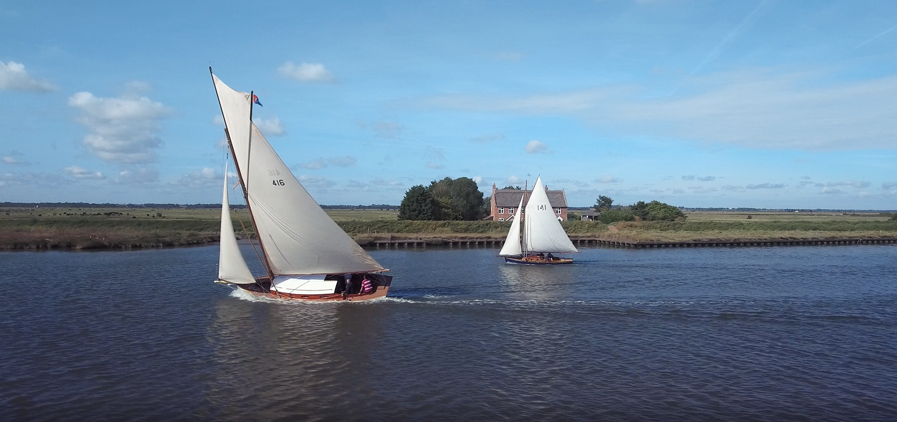
Welcome to the
Educational resource partner providers

Slide 2
To start:
What do we know about the Broads already?
You have 3 minutes to write as many different bullet points as you can – stating anything you know about the Broads:
Think about?
Where are they?
What are they?
Why are they popular?
How were they formed?
What can you do there?
Why is it a National Park?
Why are they managed?
Who may visit?
Which towns and cities are near?

Slide 3
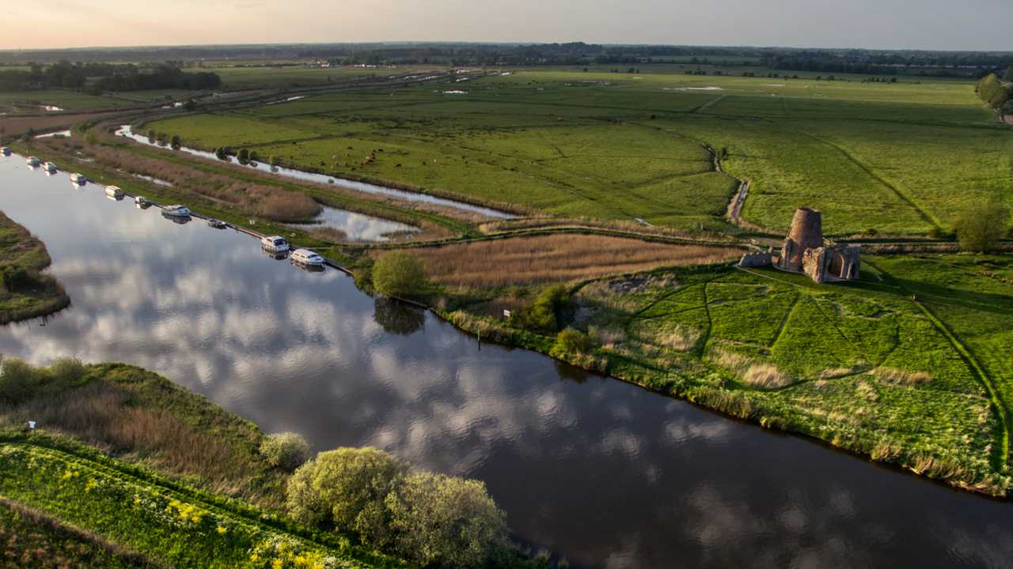
What makes the Broads unique?
In this lesson, we will:
Consider some of the special qualities and attraction of the Broads
Develop our locational knowledge of the Broads
Consider how the Broads are perceived

Slide 4
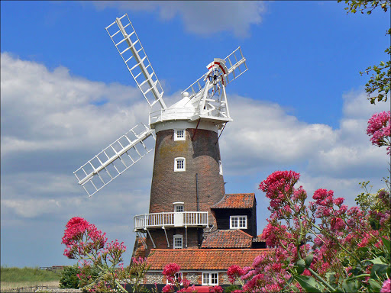
Main attractions of the Broads:
Broads or not?
You are about to see
10 different images – numbered 1-10.
Consider each picture and make a judgement as to whether you think the image is from the Broads or not (somewhere else)
Example:
Is this photo taken from the
Broads or not

Slide 5
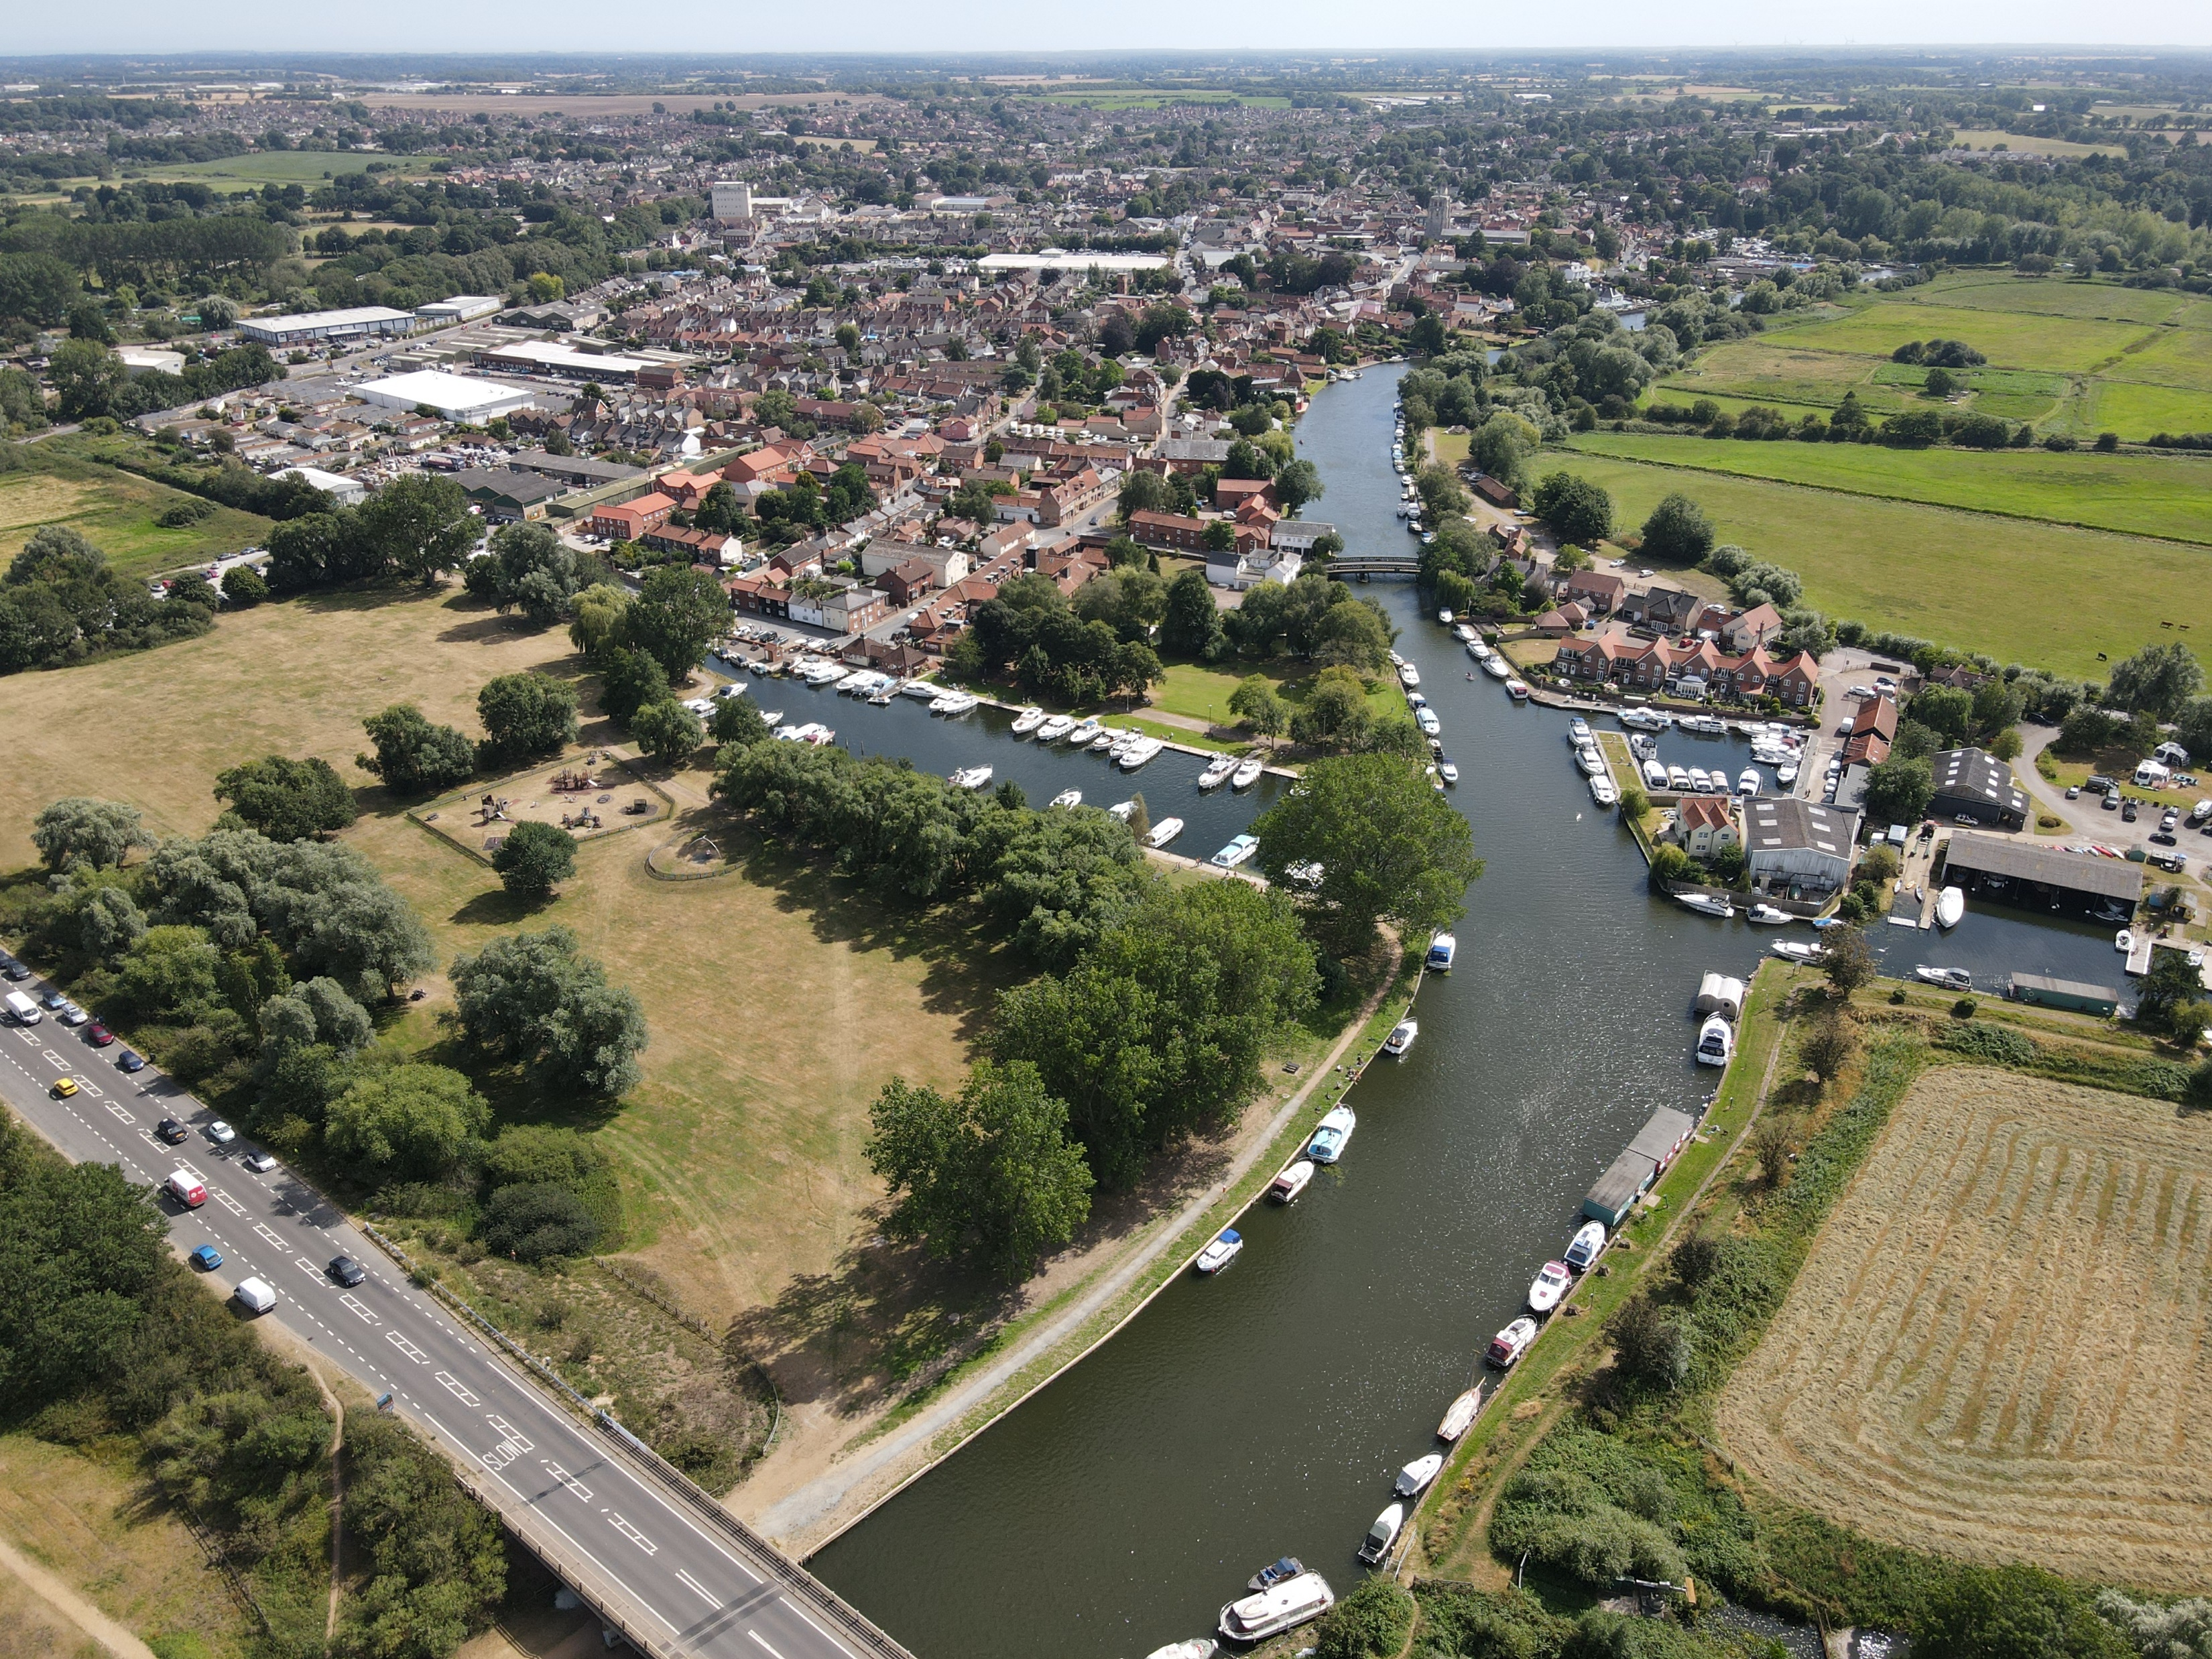
Main attractions and special qualities of the Broads:
Photograph 1:
Is this photo taken from the
Broads or not

Slide 6
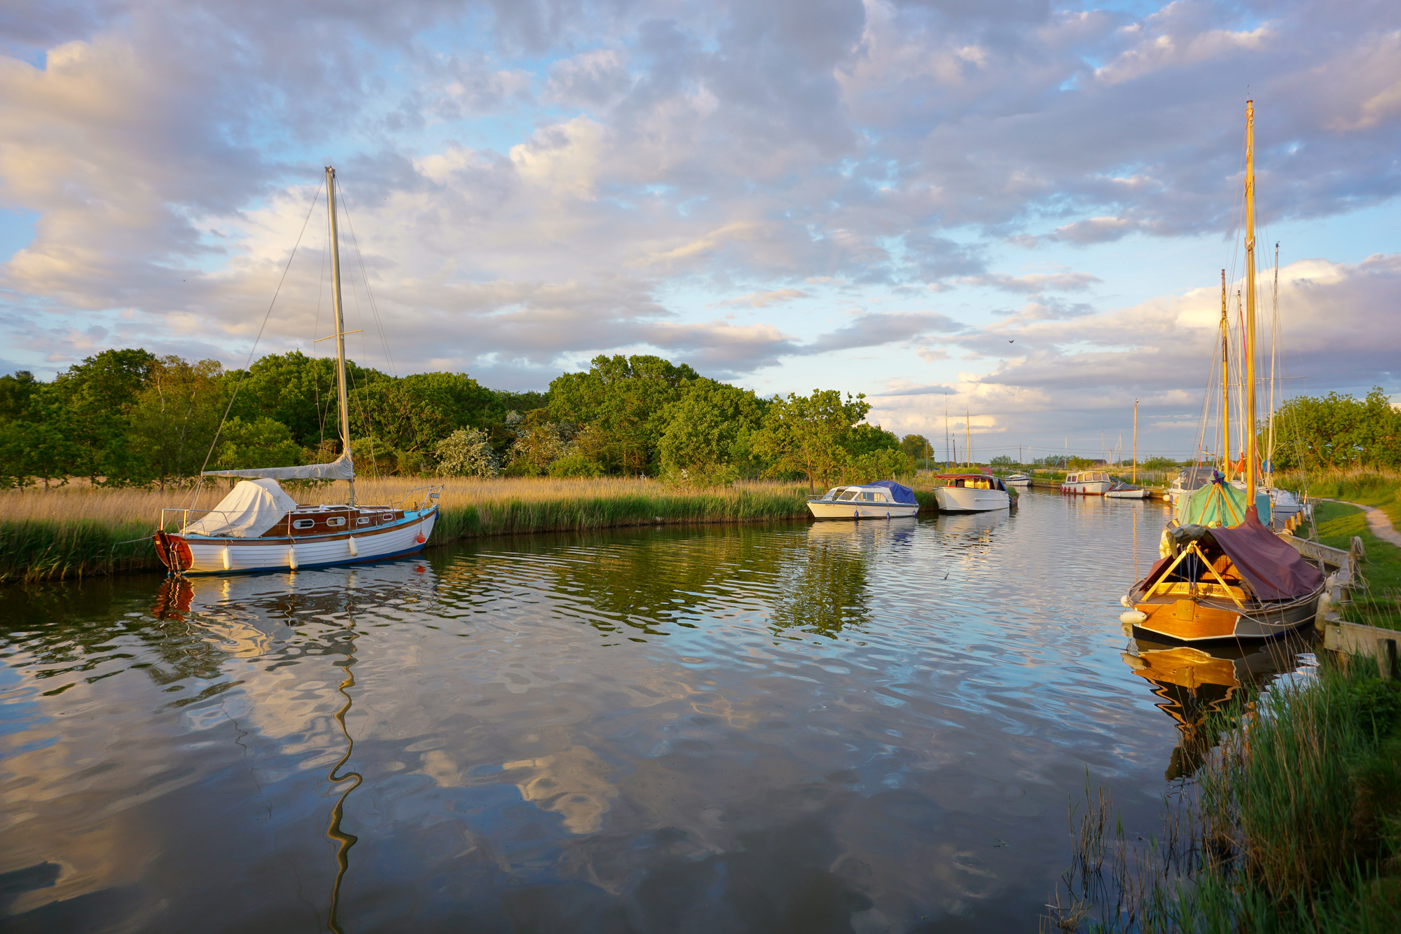
Main attractions and special qualities of the Broads:
Photograph 2:
Is this photo taken from the
Broads or not

Slide 7
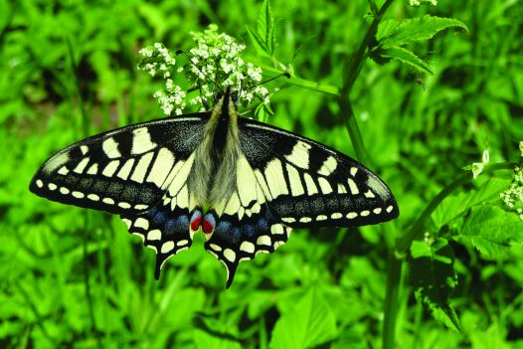
Main attractions and special qualities of the Broads:
Photograph 3:
Is this photo taken from the
Broads or not

Slide 8
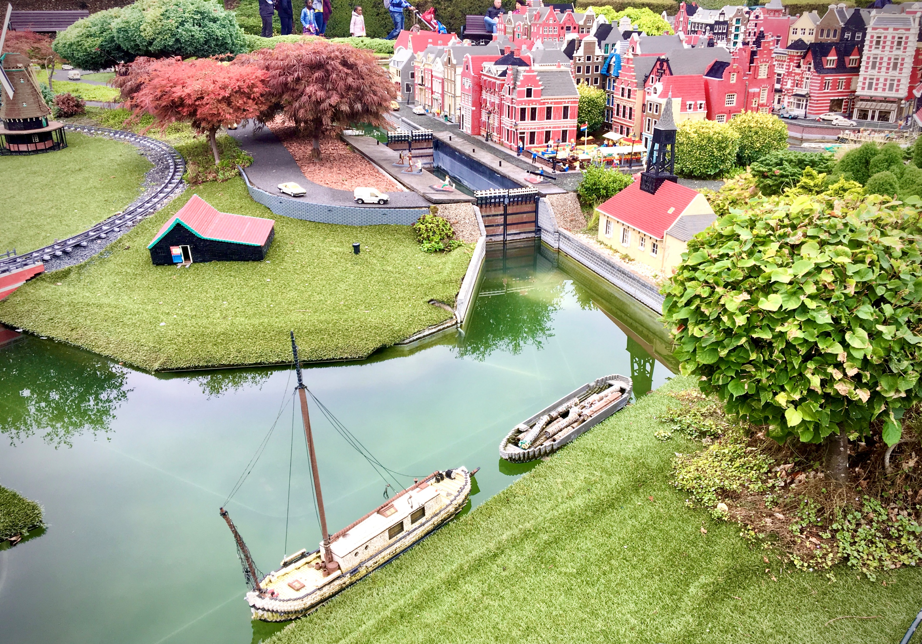
Main attractions and special qualities of the Broads:
Photograph 4:
Is this photo taken from the
Broads or not

Slide 9
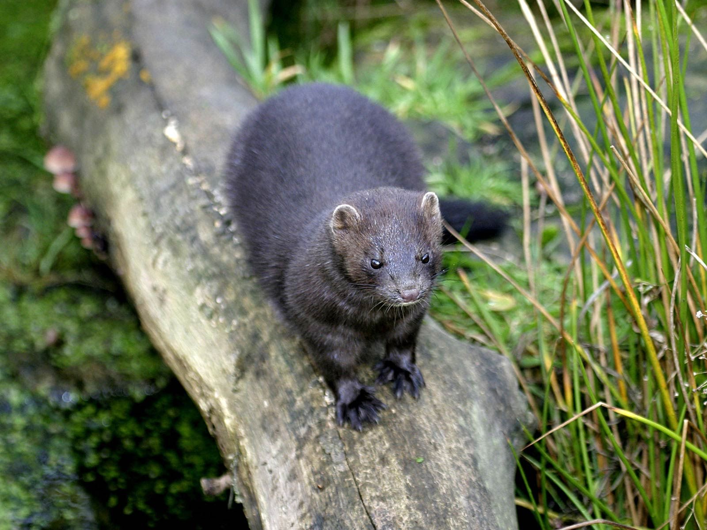
Main attractions and special qualities of the Broads:
Photograph 5:
Is this photo taken from the
Broads or not

Slide 10
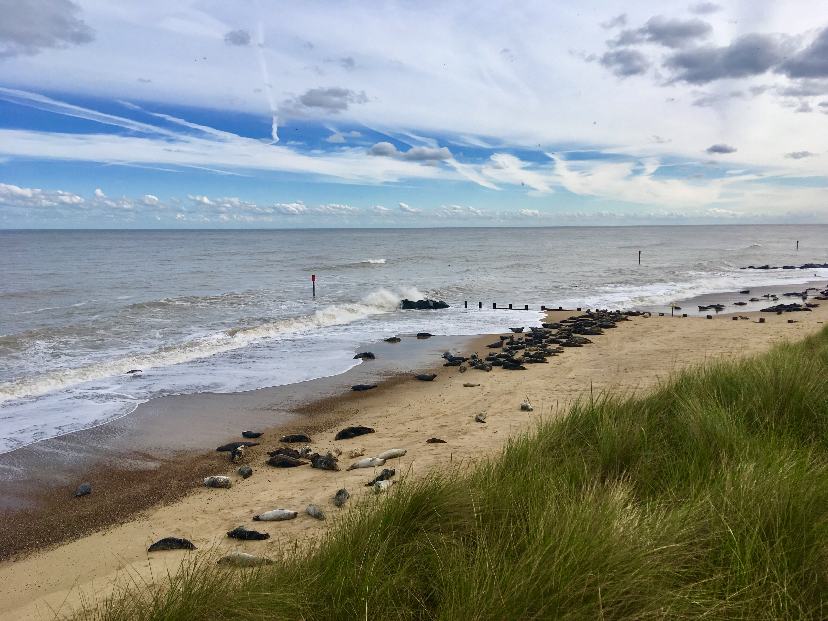
Main attractions and special qualities of the Broads:
Photograph 6:
Is this photo taken from the
Broads or not

Slide 11
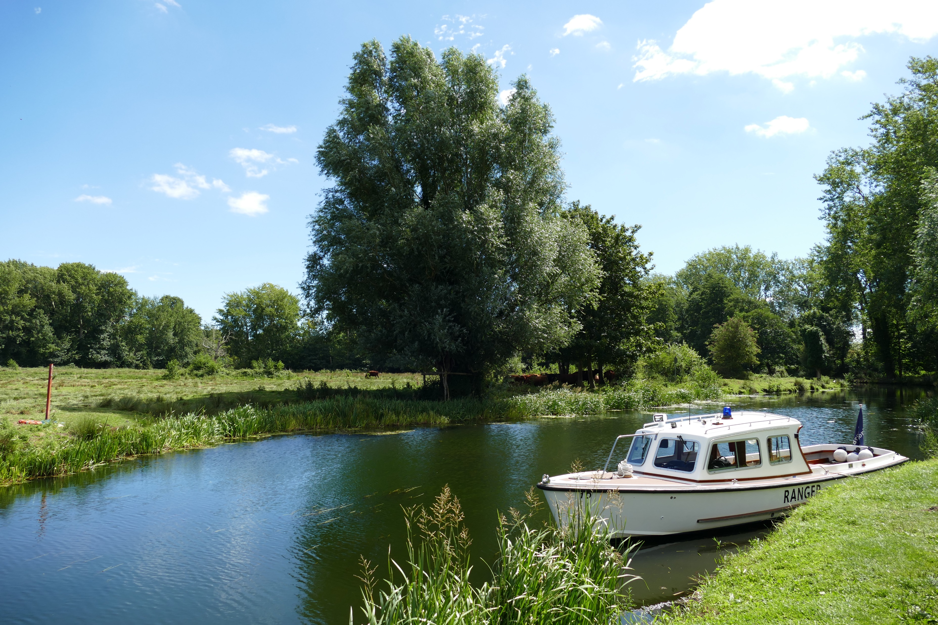
Main attractions and special qualities of the Broads:
Photograph 7:
Is this photo taken from the
Broads or not

Slide 12
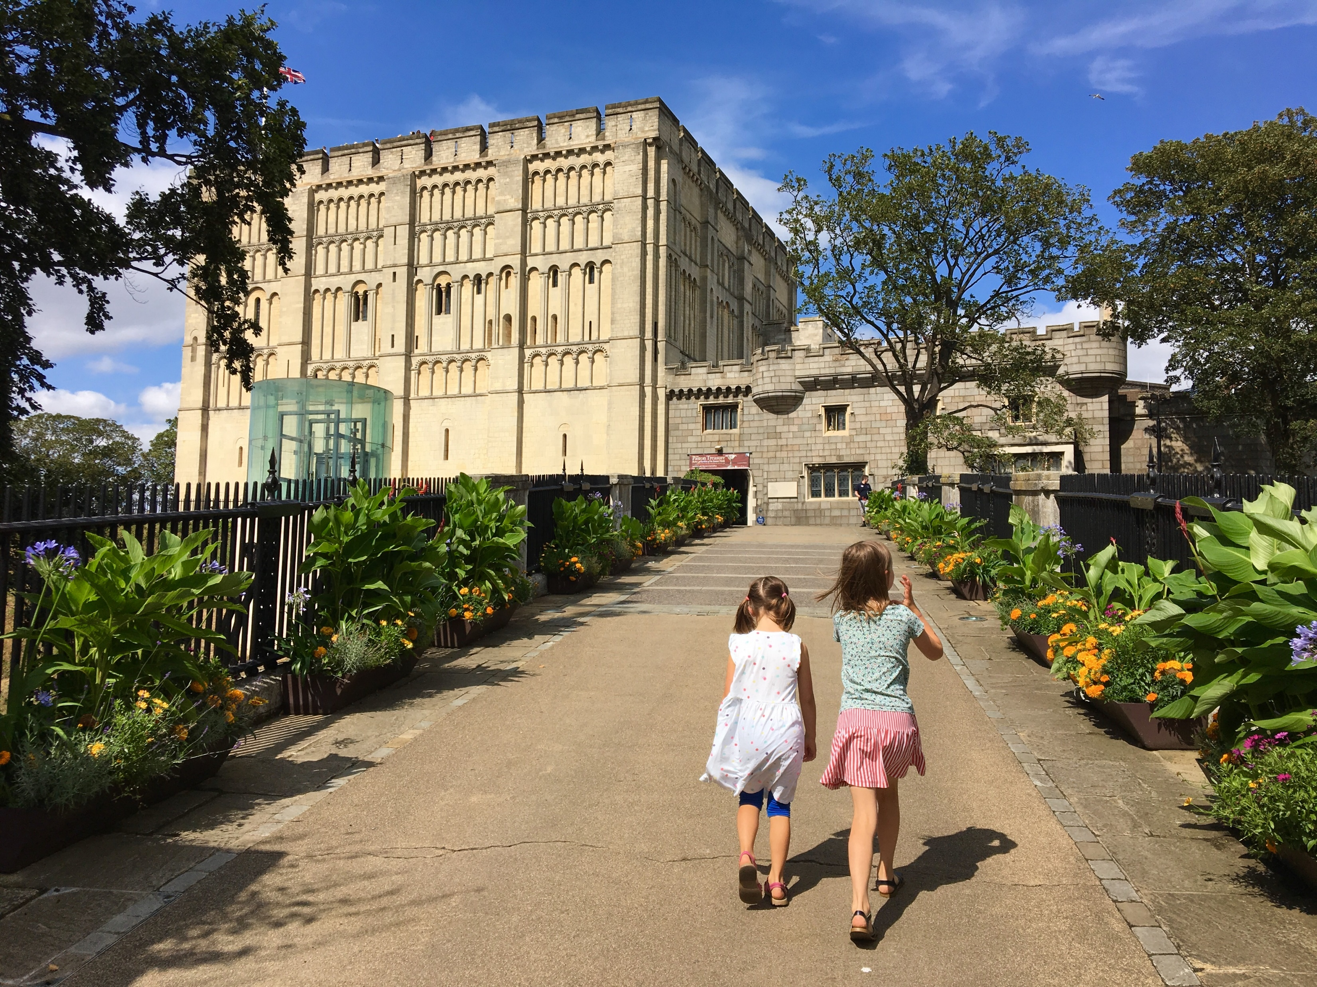
Main attractions and special qualities of the Broads:
Photograph 8:
Is this photo taken from the
Broads or not

Slide 13
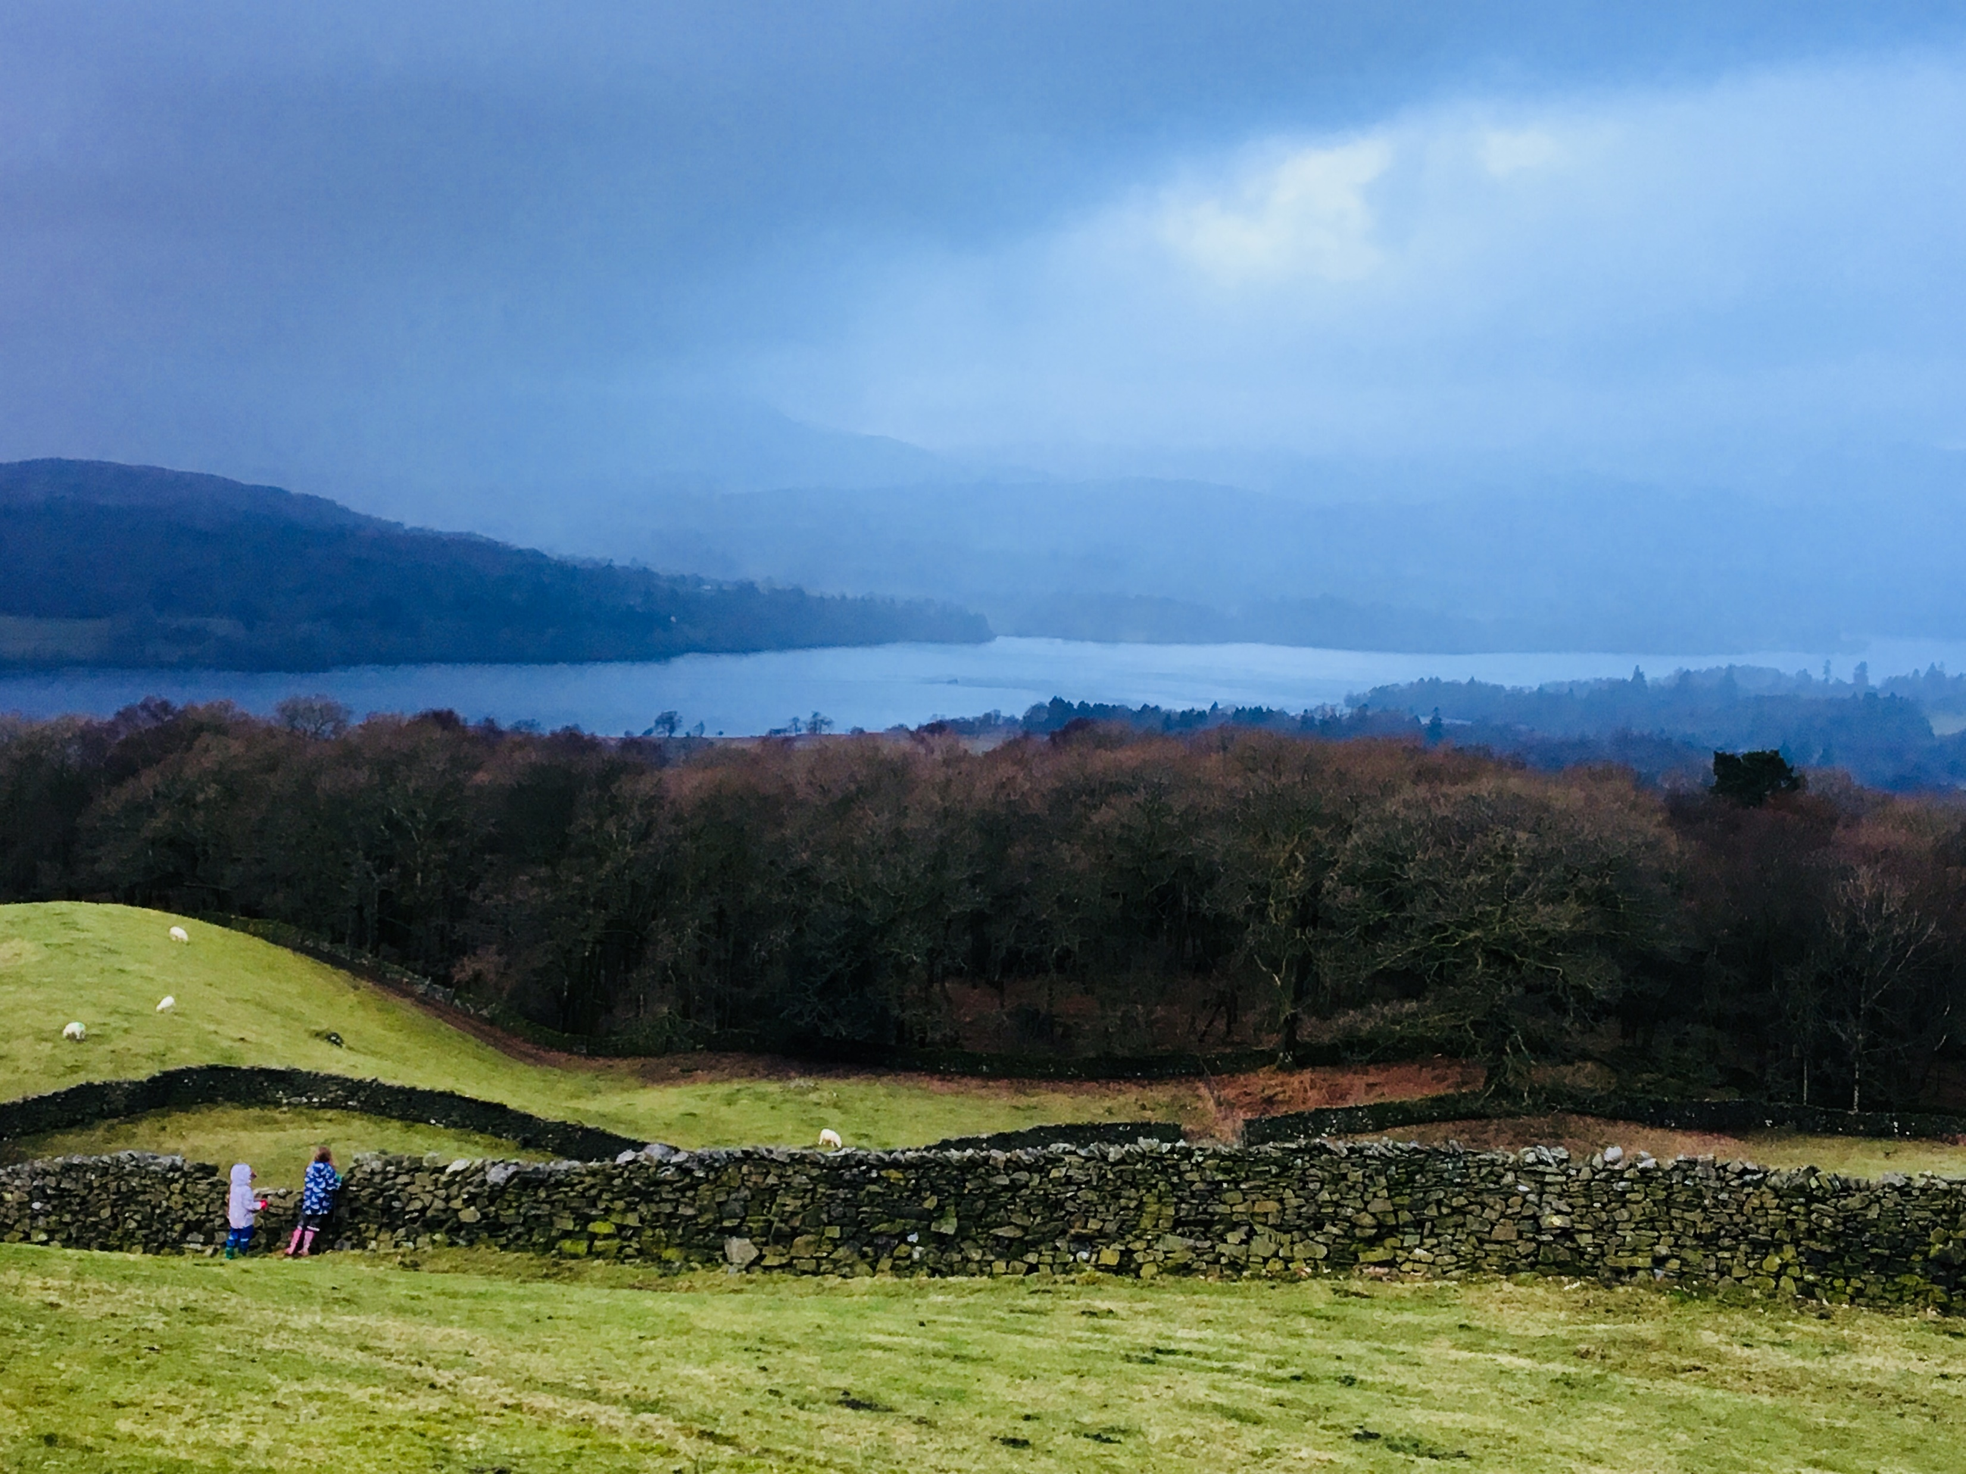
Main attractions and special qualities of the Broads:
Photograph 9:
Is this photo taken from the
Broads or not

Slide 14
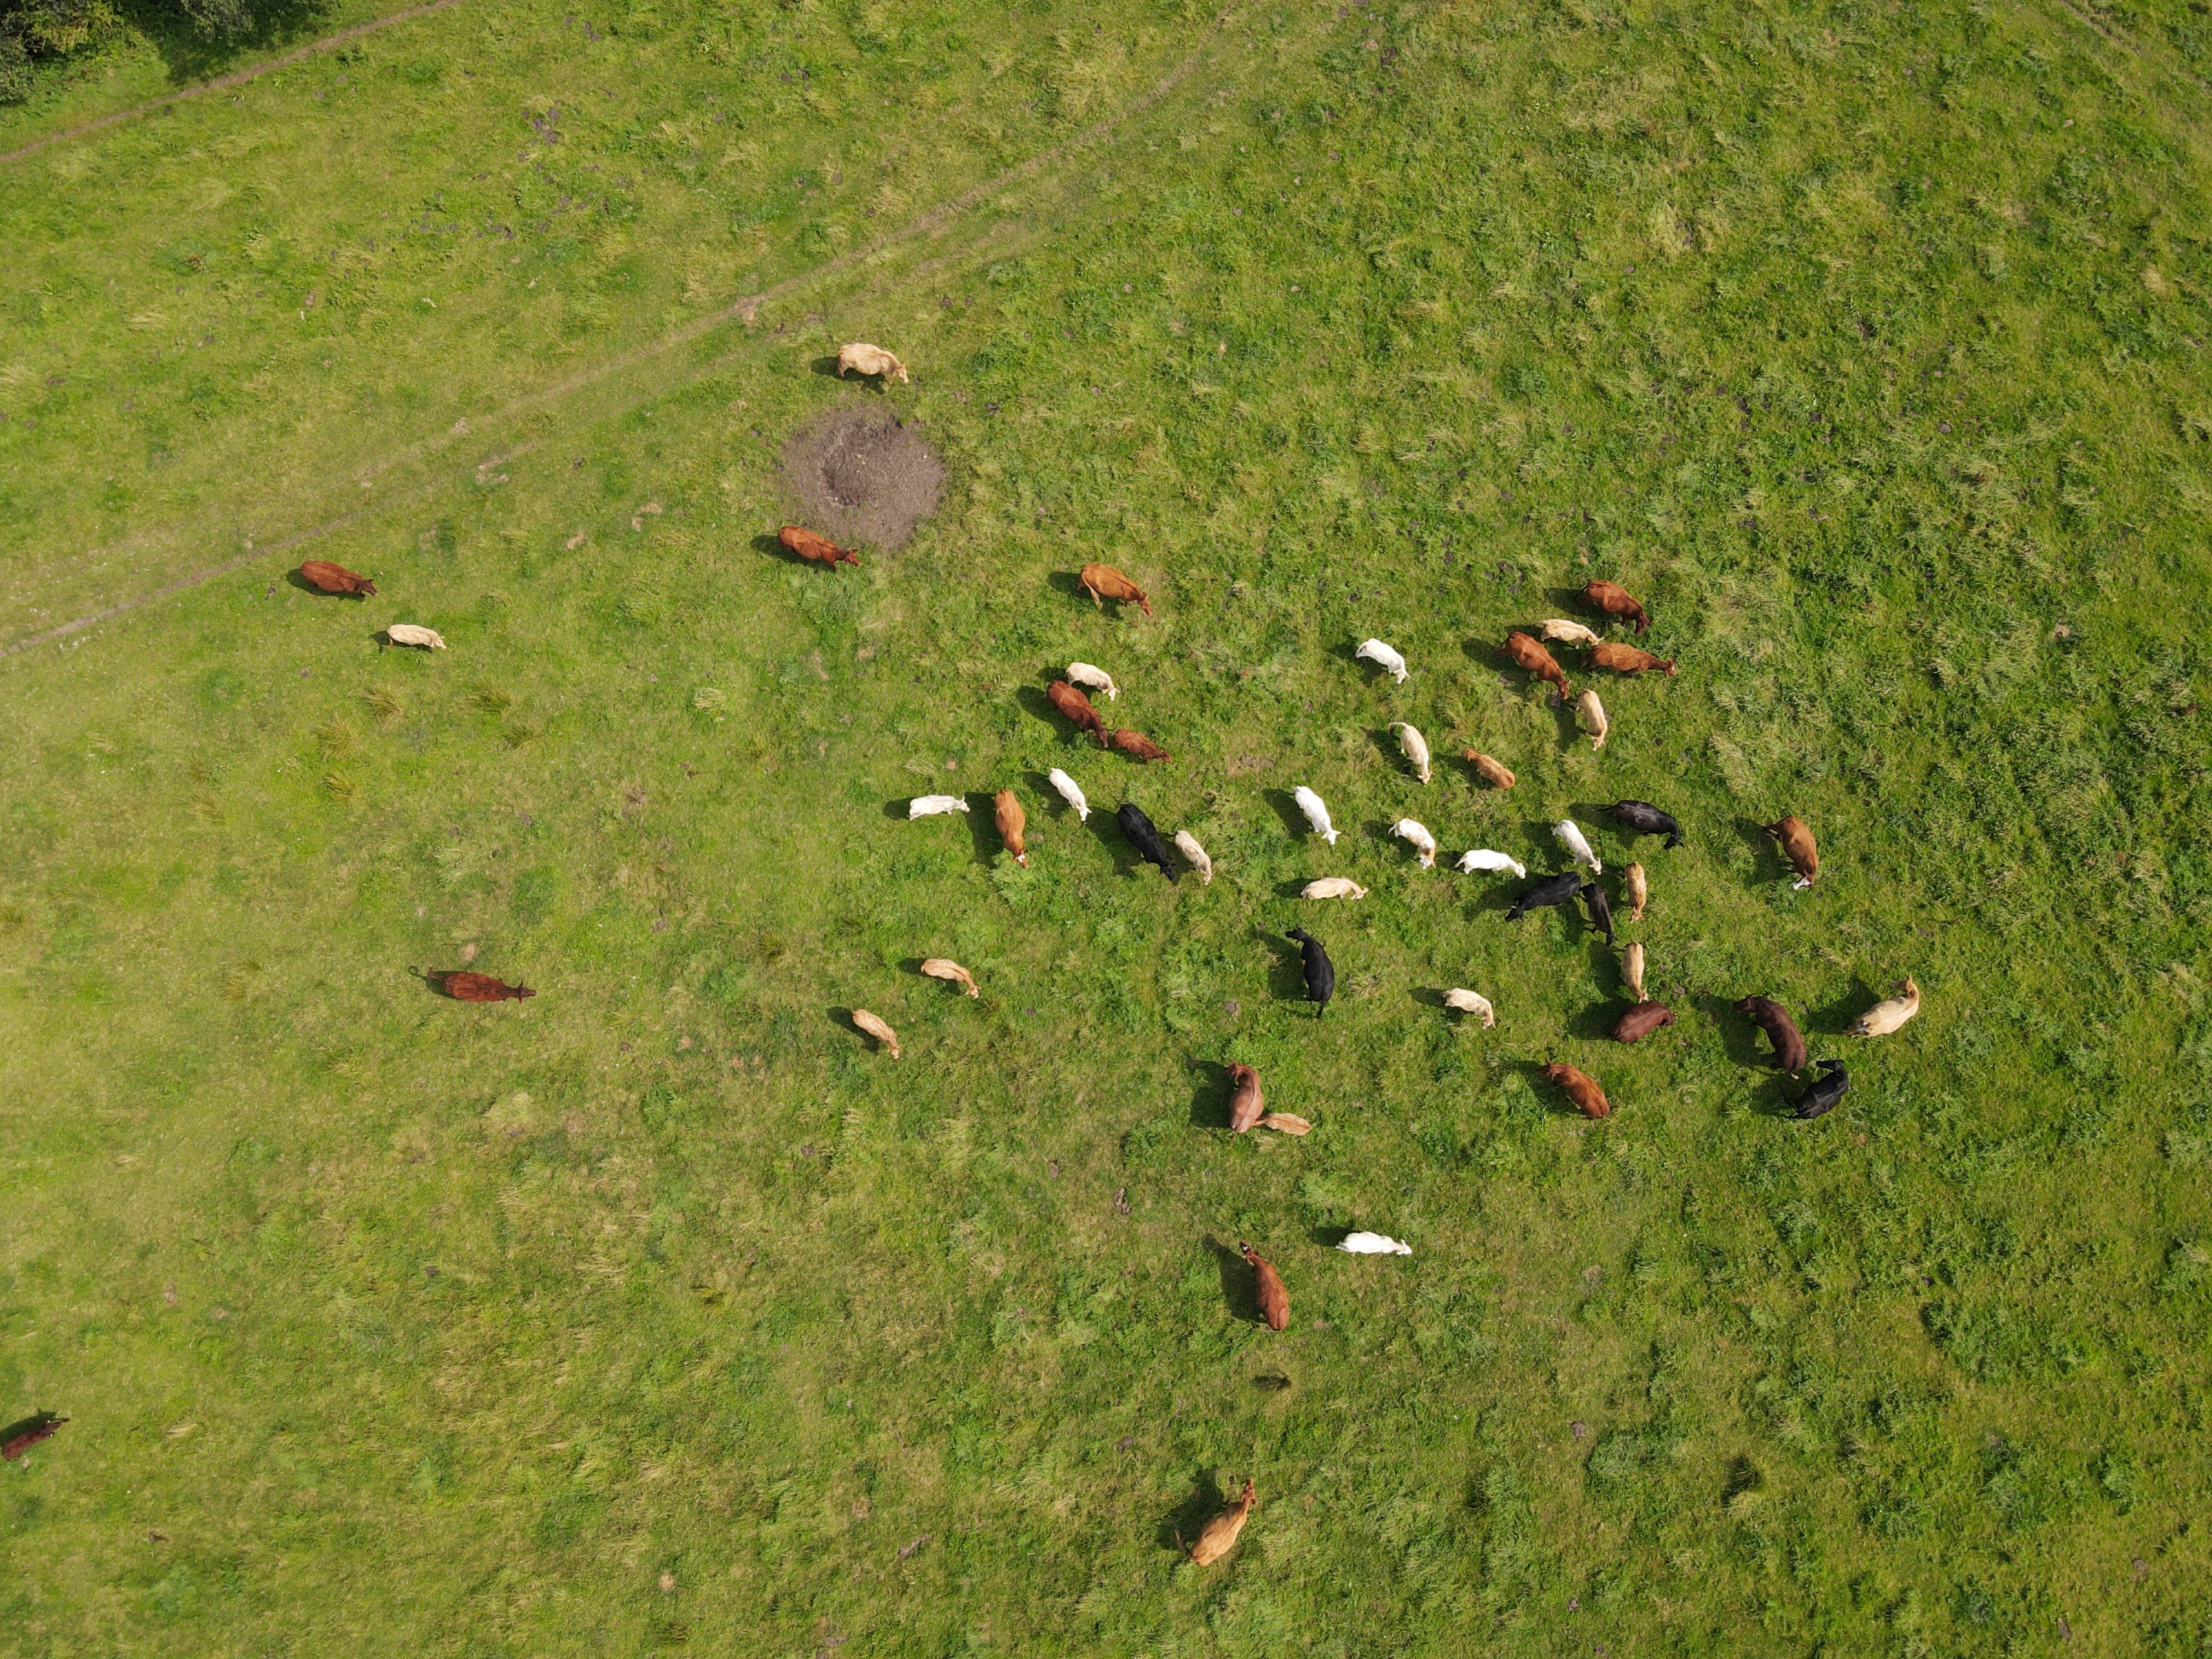
Main attractions and special qualities of the Broads:
Photograph 10:
Is this photo taken from the
Broads or not

Slide 15
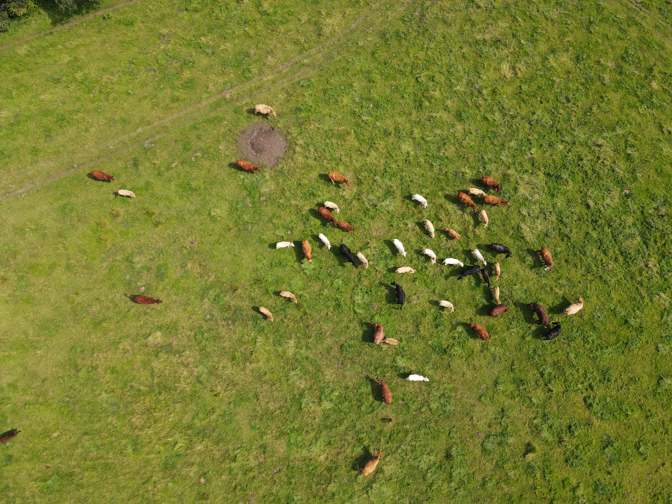
Main attractions and special qualities of the Broads:
Broads or not?
Which of the 10 images did you think were in the Broads National Park?

Slide 16
Main attractions and special qualities of the Broads:
Photograph 1:
Is this photo taken from the
Broads or not
Broads
This is Beccles in Suffolk, one of many towns and villages which the Broads waterways connect

Slide 17
Main attractions and special qualities of the Broads:
Photograph 2:
Is this photo taken from the
Broads or not
Broads
The Broads has more miles of waterways than both Venice and Amsterdam

Slide 18
Main attractions and special qualities of the Broads:
Photograph 3:
Is this photo taken from the
Broads or not
Broads
The Broads are home to a ¼ of the rarest wildlife in the UK – like this Swallowtail butterfly

Slide 19
Main attractions and special qualities of the Broads:
Photograph 4:
Is this photo taken from the
Broads or not
Not
This is a model of Amsterdam found in Legoland!

Slide 20
Main attractions and special qualities of the Broads:
Photograph 5:
Is this photo taken from the
Broads or not
Broads
These are American mink - an ‘introduced’ species to the Broads. Mink have reduced numbers of native species such as water voles, since 2006 efforts have been made to control mink numbers in the Broads.

Slide 21
Main attractions and special qualities of the Broads:
Photograph 6:
Is this photo taken from the
Broads or not
Broads
The Broads includes a small stretch of Norfolk coast. The beach here at Horsey is backed by sand dunes and is one of the UK’s largest seal colonies.

Slide 22
Main attractions and special qualities of the Broads:
Photograph 7:
Is this photo taken from the
Broads or not
Broads
This is a Broads rangers patrol boat. A team of rangers cover the entire Broads network to ensure the National Park is safe for everyone to use and enforcing rules where needed.

Slide 23
Main attractions and special qualities of the Broads:
Photograph 8:
Is this photo taken from the
Broads or not
Not
This is nearby Norwich castle! Not quite in the National Park but a popular day trip for tourists.

Slide 24
Main attractions and special qualities of the Broads:
Photograph 9:
Is this photo taken from the
Broads or not
Not
This is Lake Windermere in the Lake District National Park. England’s longest lake.

Slide 25
Main attractions and special qualities of the Broads:
Photograph 10:
Is this photo taken from the
Broads or not
Broads
What did you score out of 10?
The Broads is a haven for grazing cows. The rich grass is perfect for rearing healthy beef cattle herds and there are often more cows in the Broads than people!

Slide 26
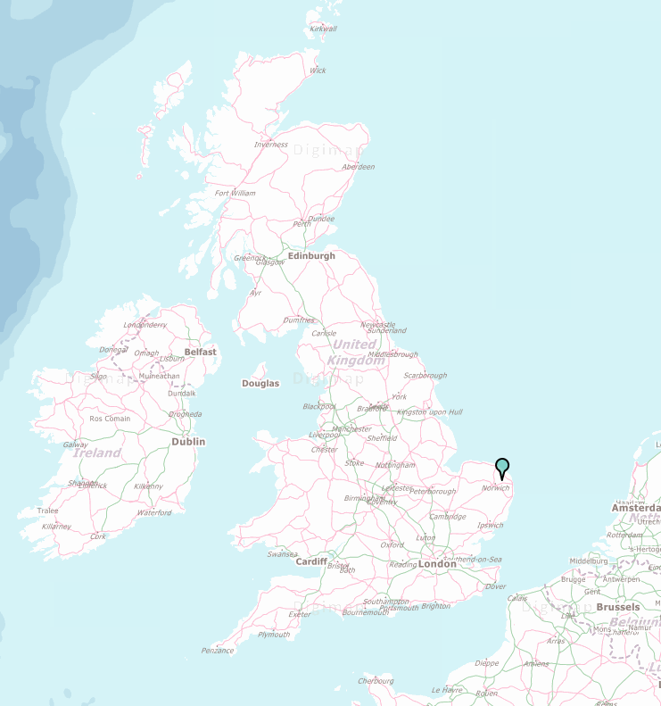
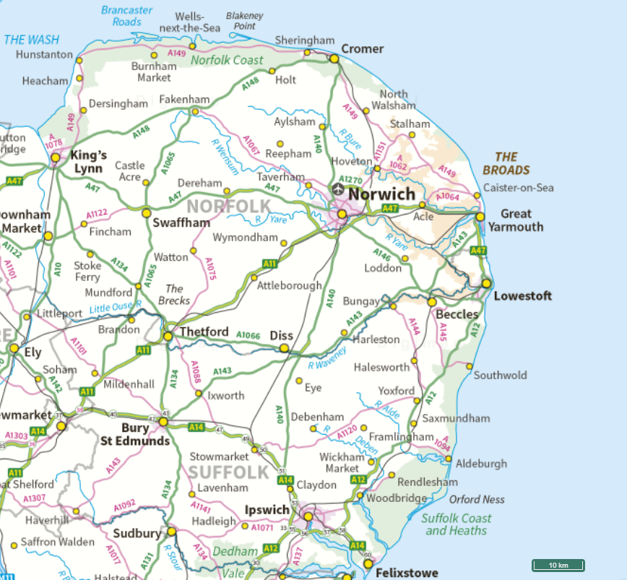
Mapping the location of the Broads:

Slide 27
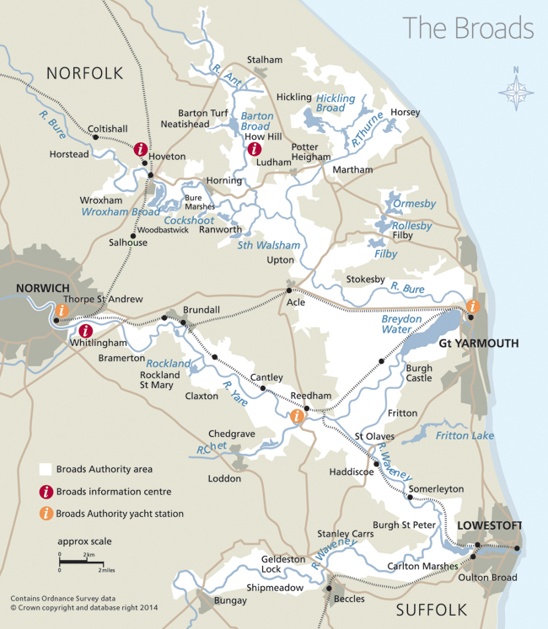
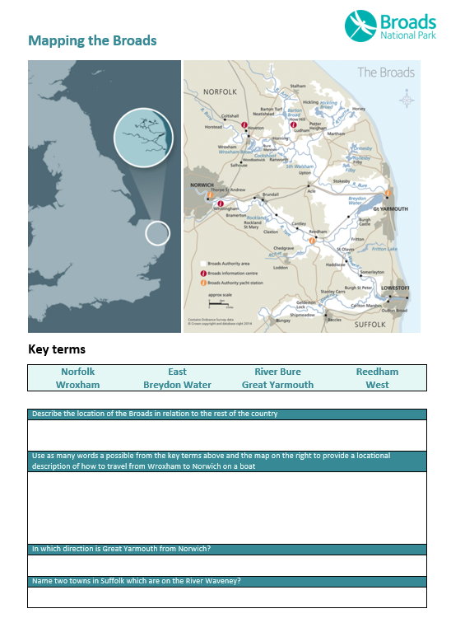

Slide 28
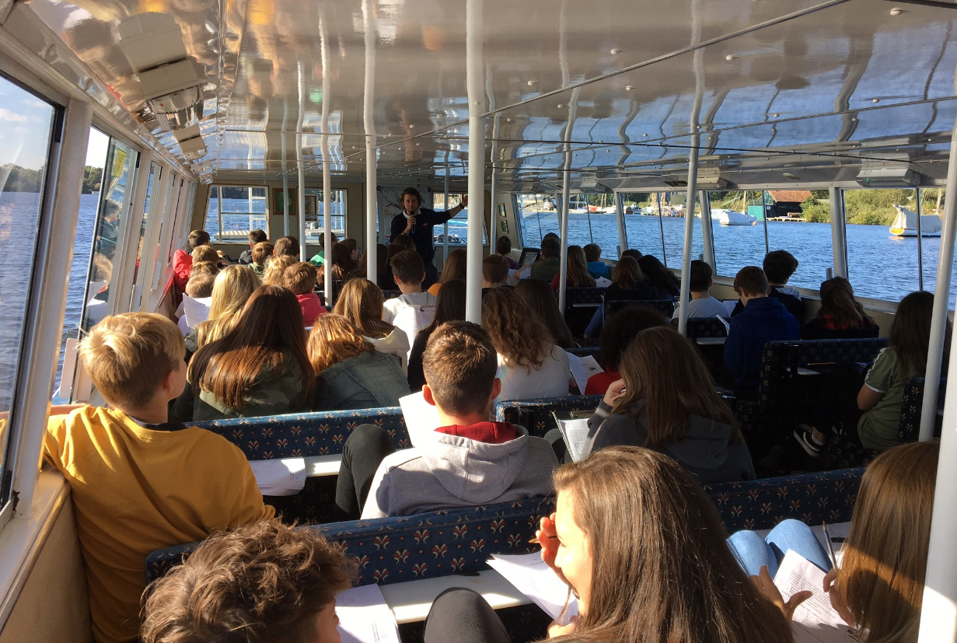
How are the Broads perceived:
The Broads are famous internationally, but what is it that people like about the area?

Slide 29
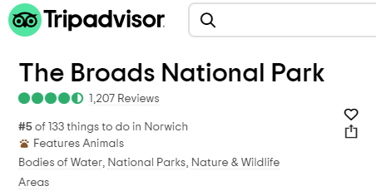
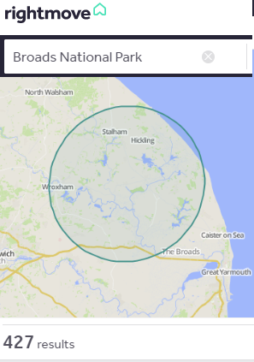
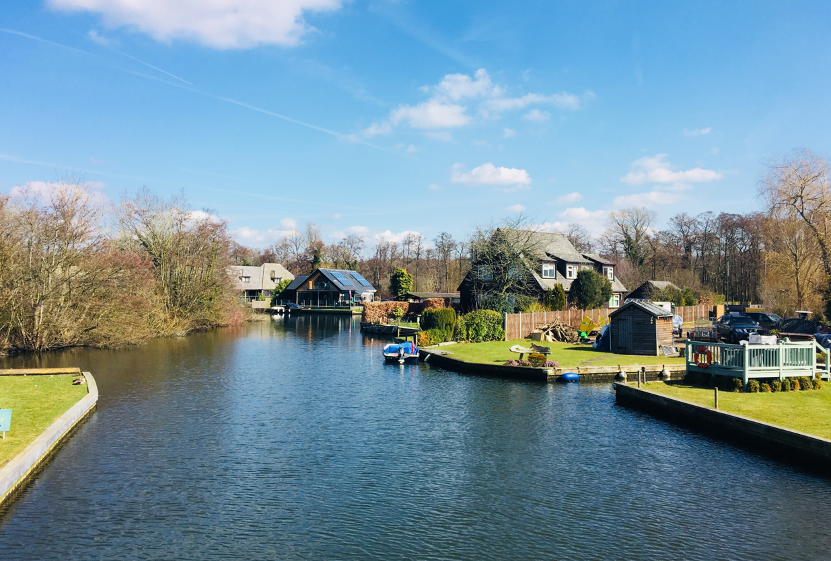
How are the Broads perceived?
Perception:
Is the way in which we regard, understand or see something. We can attempt to gauge ‘perceptions’ in many ways …

Slide 30
How are the Broads perceived?
Creating WordArt to show perceptions of the Broads:

Slide 31
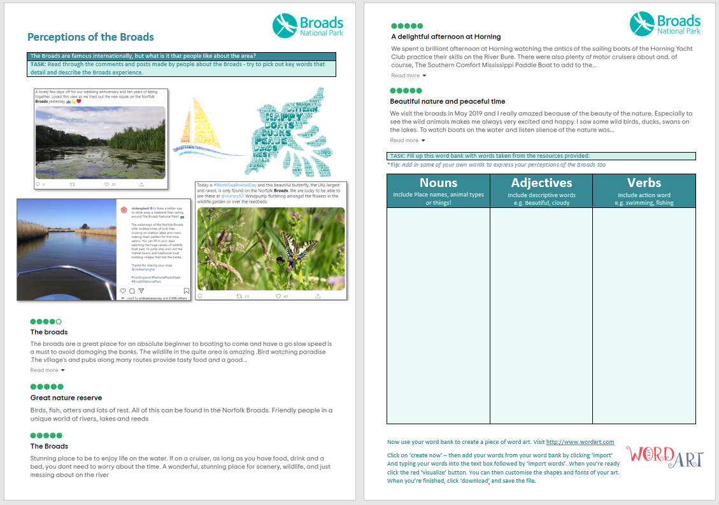
How are the Broads perceived?

Slide 32
In this lesson, we have:
Considered some of the special qualities and attraction of the Broads
Developed our locational knowledge of the Broads
Considered how the Broads are perceived
Challenge 1
Challenge 2
Challenge 3
Name 5 specific attractions of the Broads
Name 1 – City close by
Name 2 –Broads
Name 3 – Rivers in the Broads National Park
Create a 10 word ‘tag-line’ to sum up the Broads
Educational resource partner providers

