Slide 1
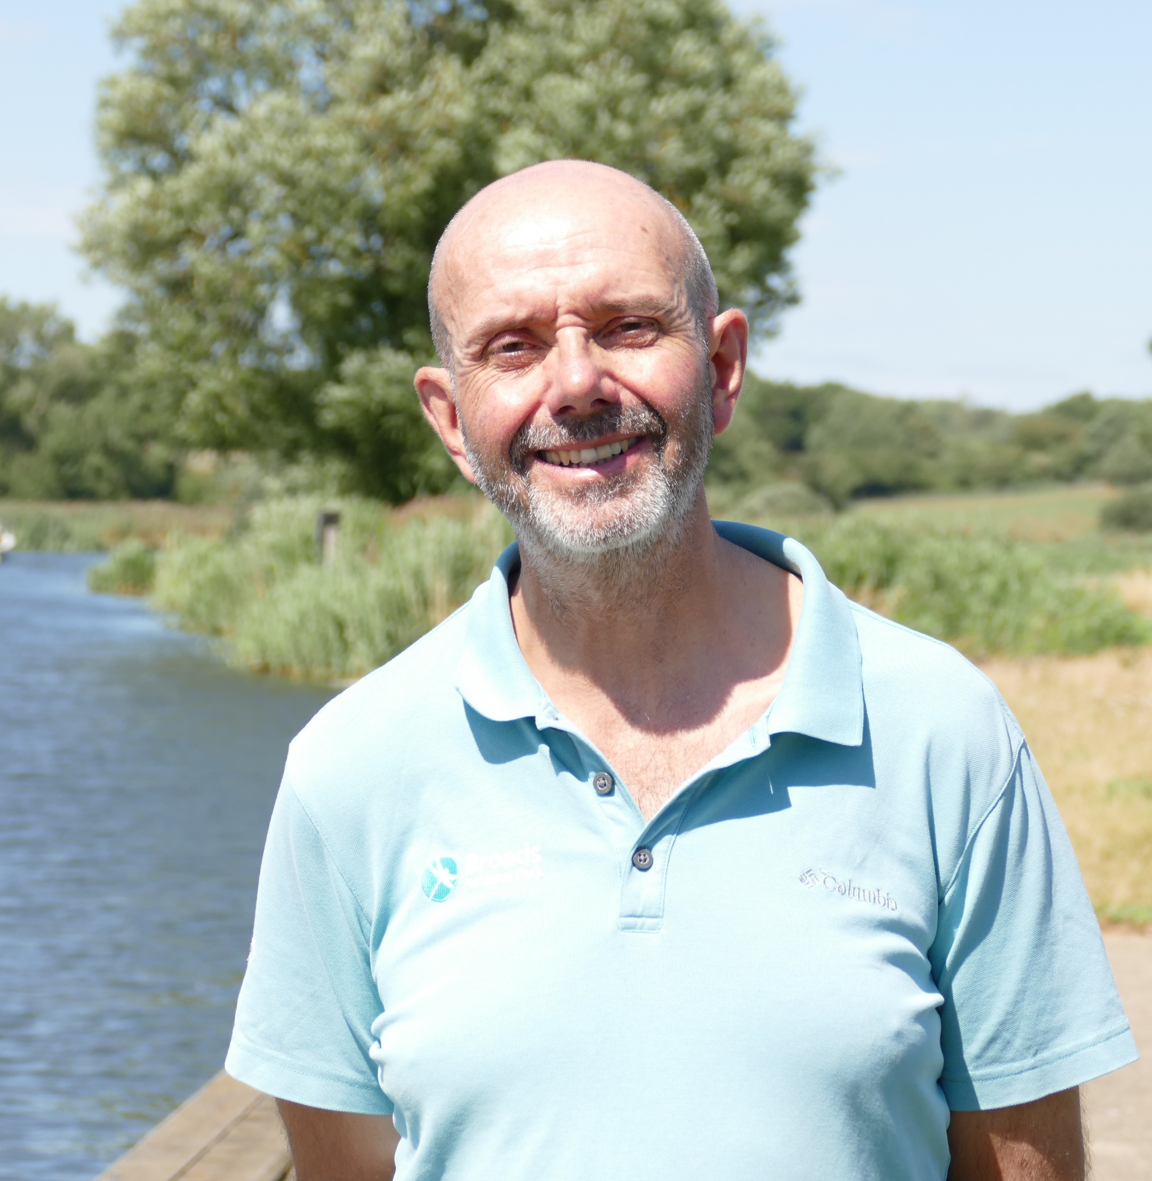
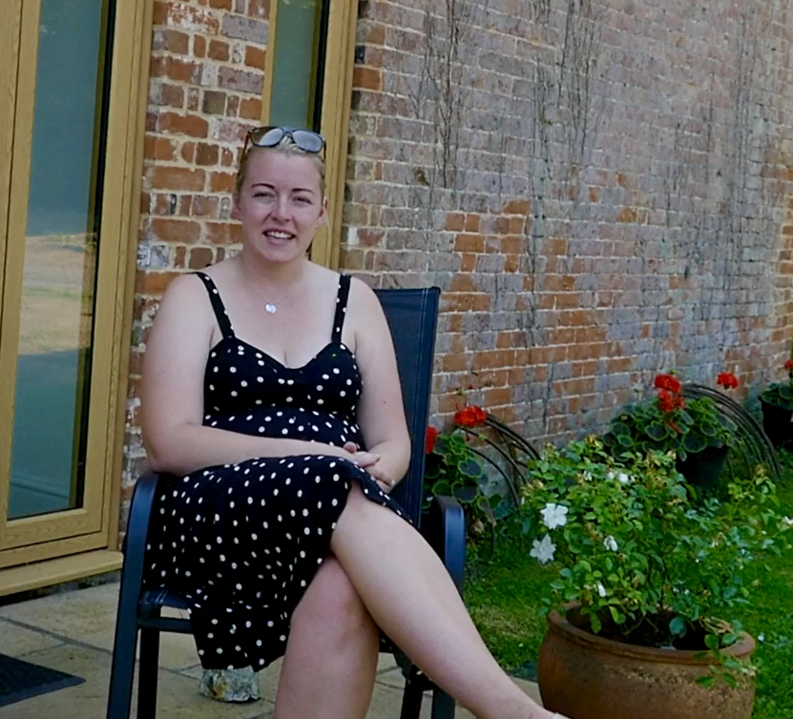
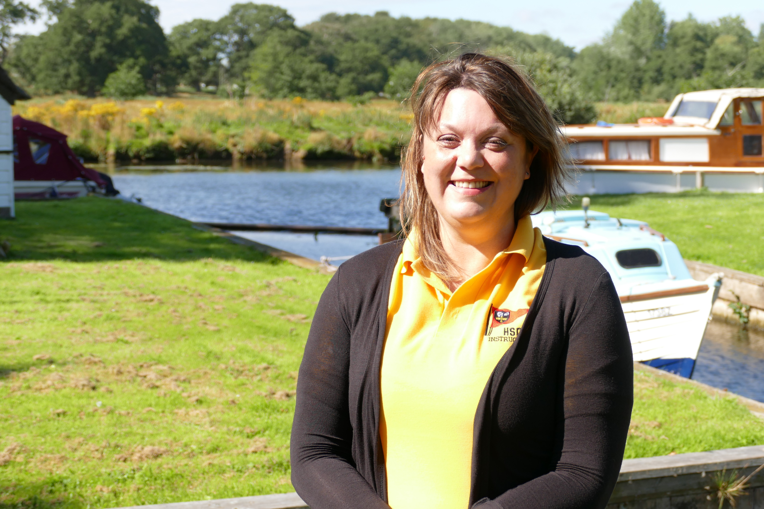
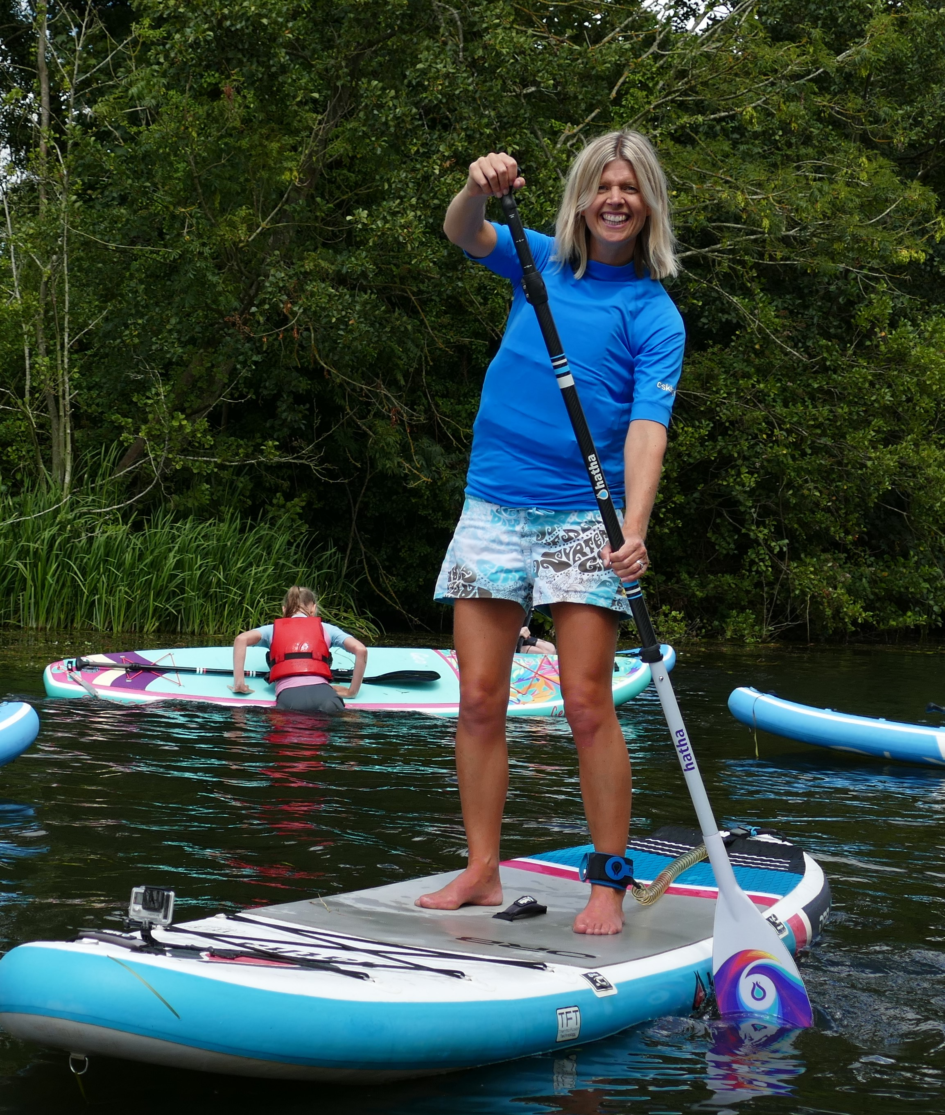
Geog your memory
How much can you remember from last time?
What is the name of the organisation which looks after the Broads?
Name 2 benefits of tourism for local people?
Name 3 ways in which farmers could change their business to cater for tourists?
Educational resource partner providers

Slide 2
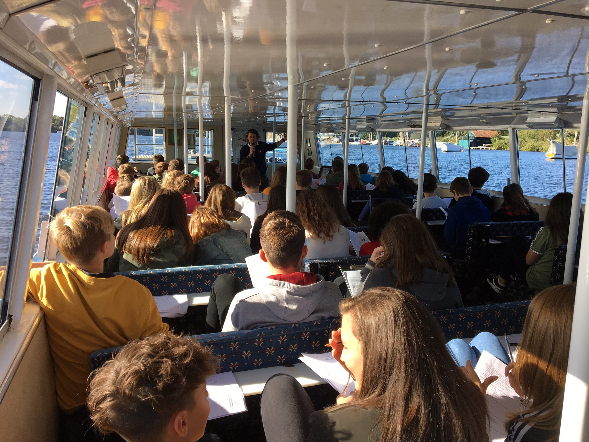
Fieldwork in the Broads
In this lesson, we will:
Understand the role of fieldwork to ask questions about the landscape
Interpret and present real fieldwork data collected from the Broads
Assess the limitations of fieldwork methods

Slide 3
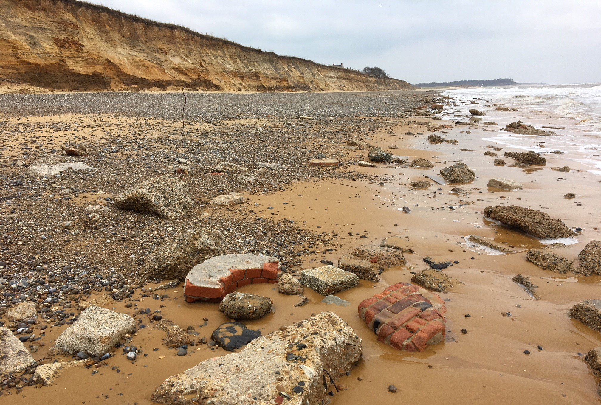
For each of the following pictures; Ask 1 or 2 questions
Your questions must start with either:
WHAT … | WHY … | WHERE … | HOW …
For example:
Why are there bricks on this beach?
Where have they come from?

Slide 4
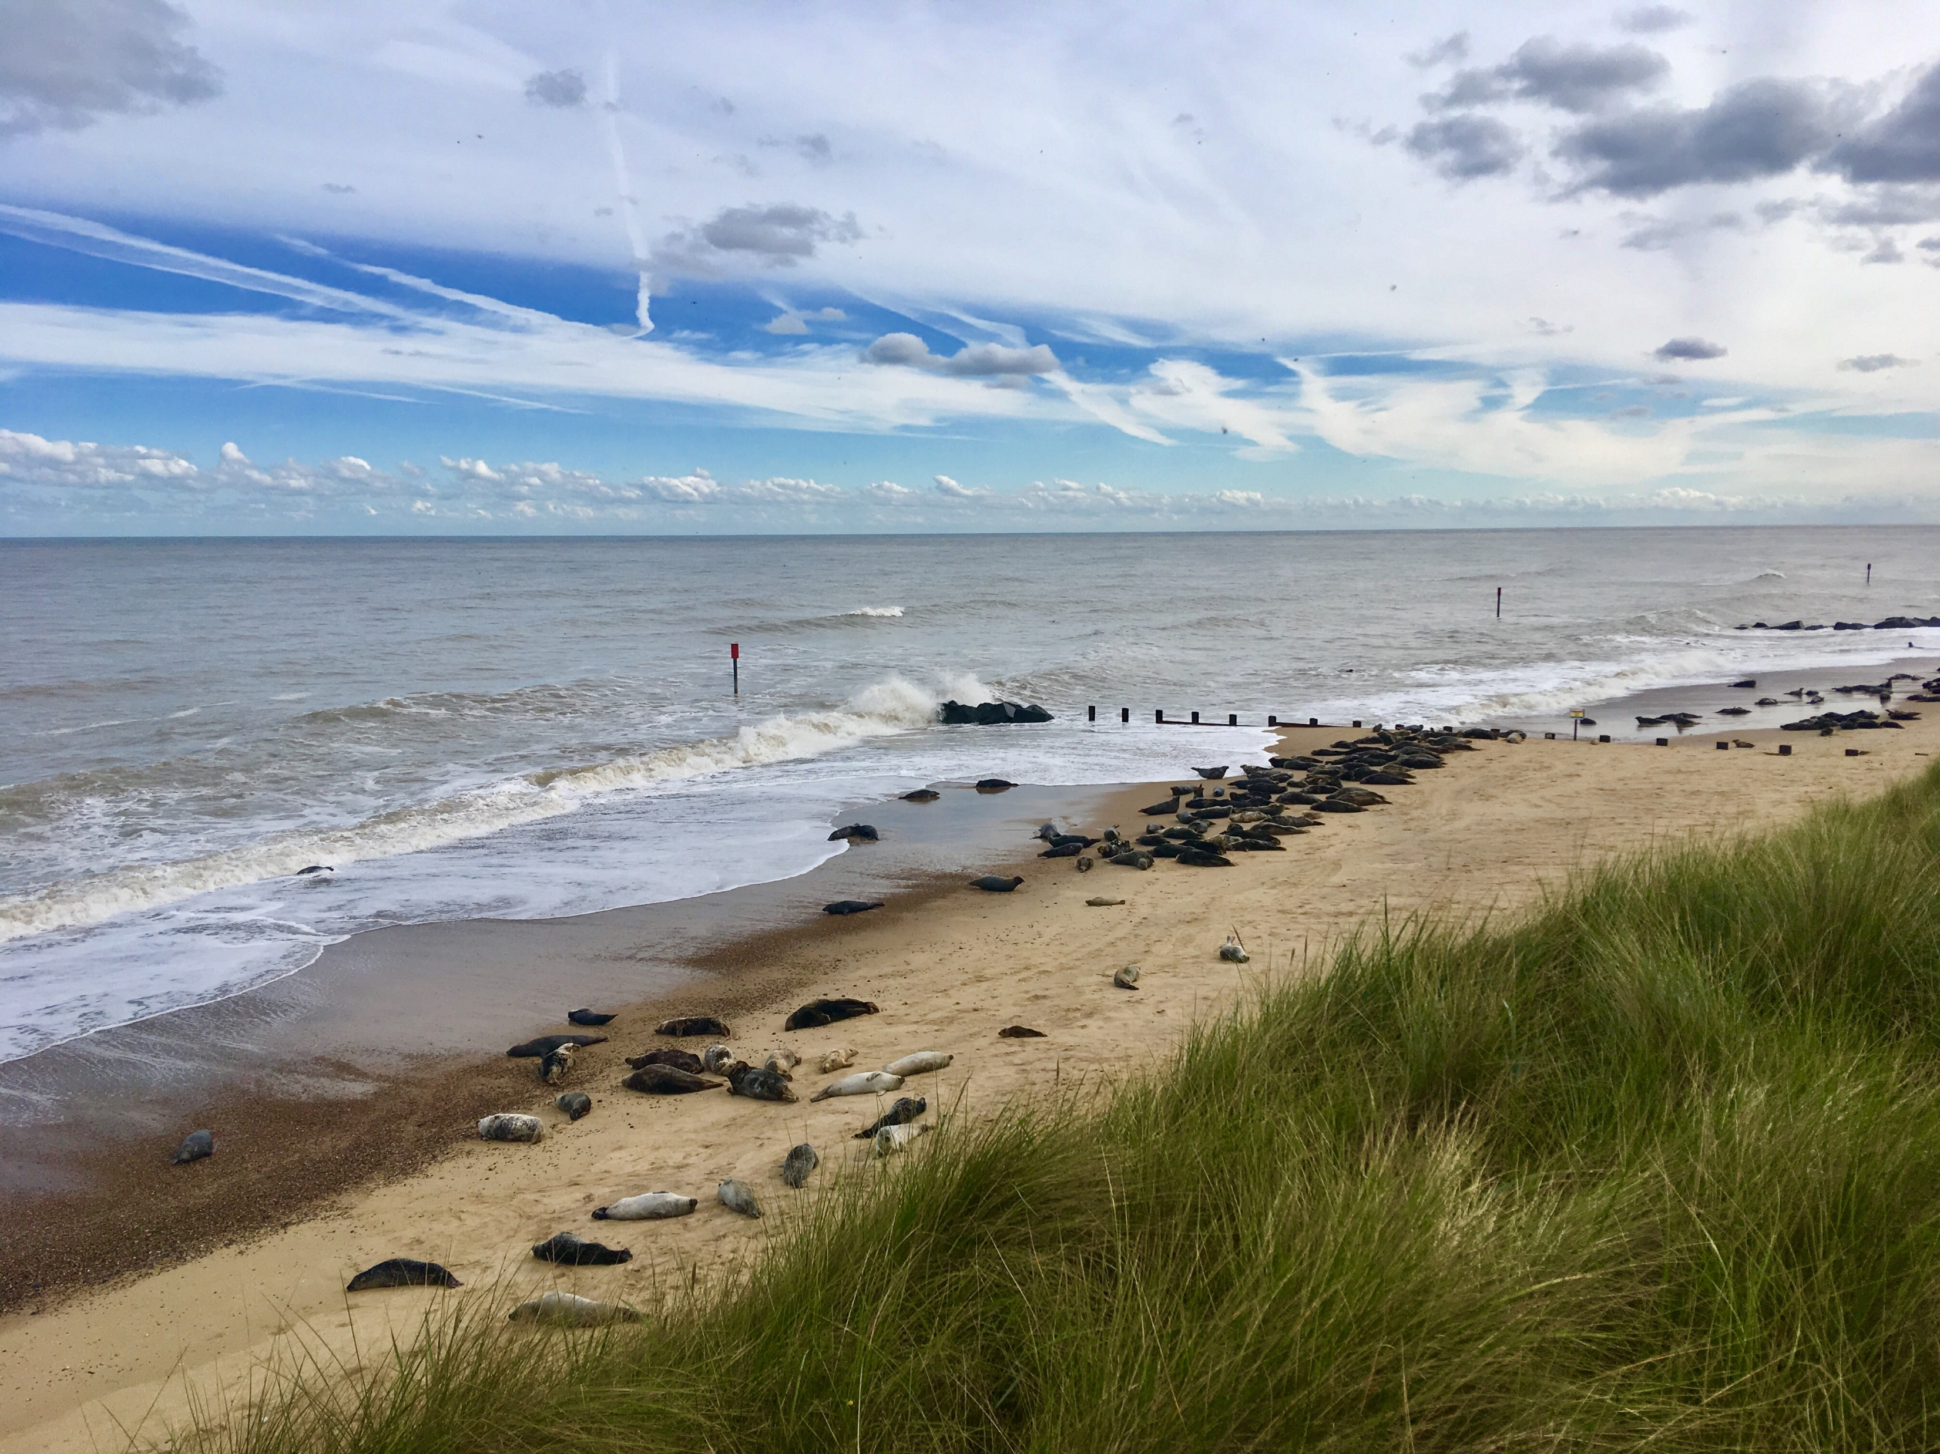
Write 1 or 2 questions for picture 1
WHAT … | WHY … | WHERE … | HOW …

Slide 5
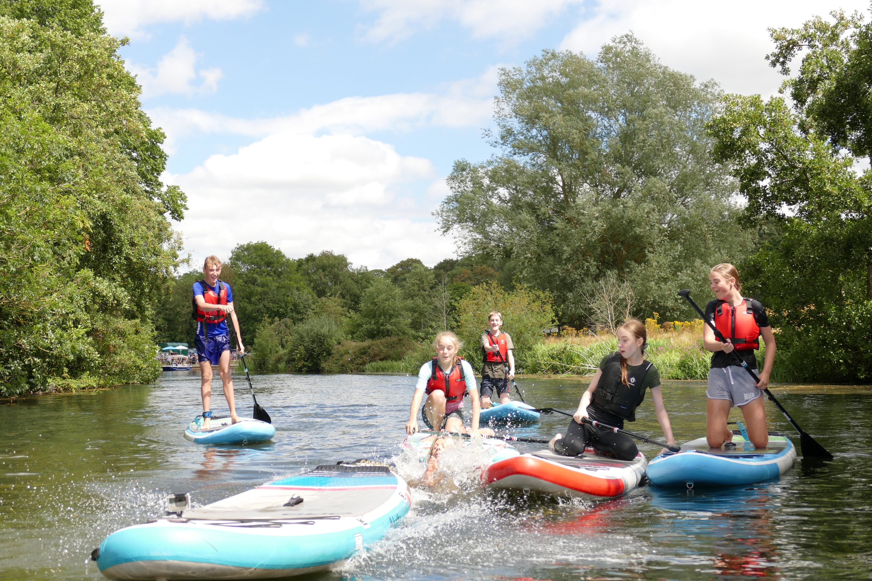
Write 1 or 2 questions for picture 2
WHAT … | WHY … | WHERE … | HOW …

Slide 6
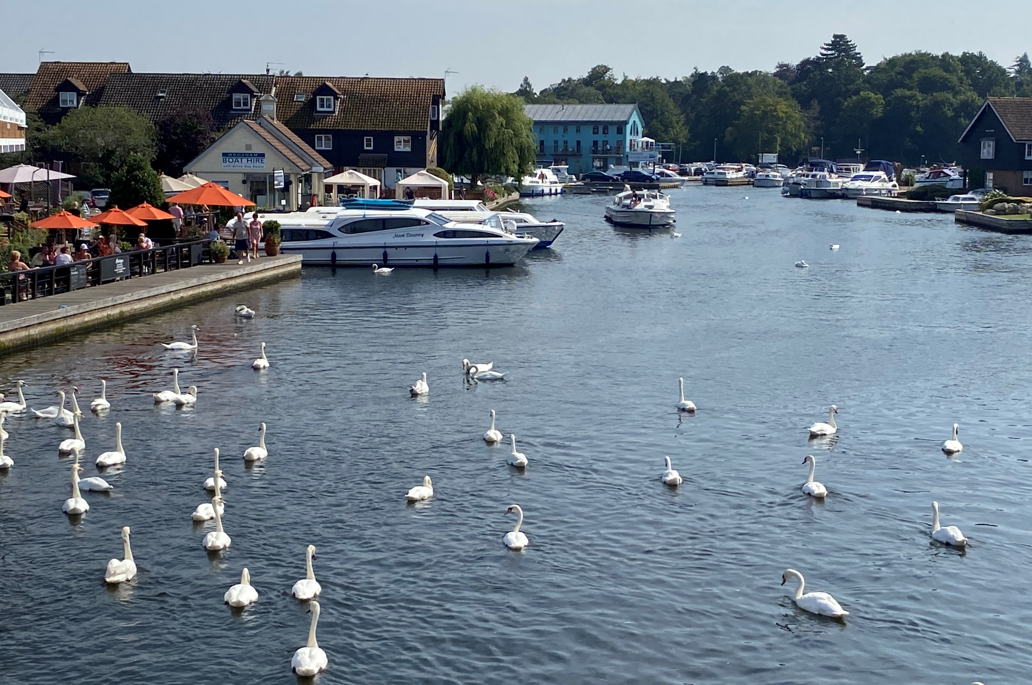
Write 1 or 2 questions for picture 3
WHAT … | WHY … | WHERE … | HOW …
Great minds don’t just ask for the answers – they ask the questions!!

Slide 7
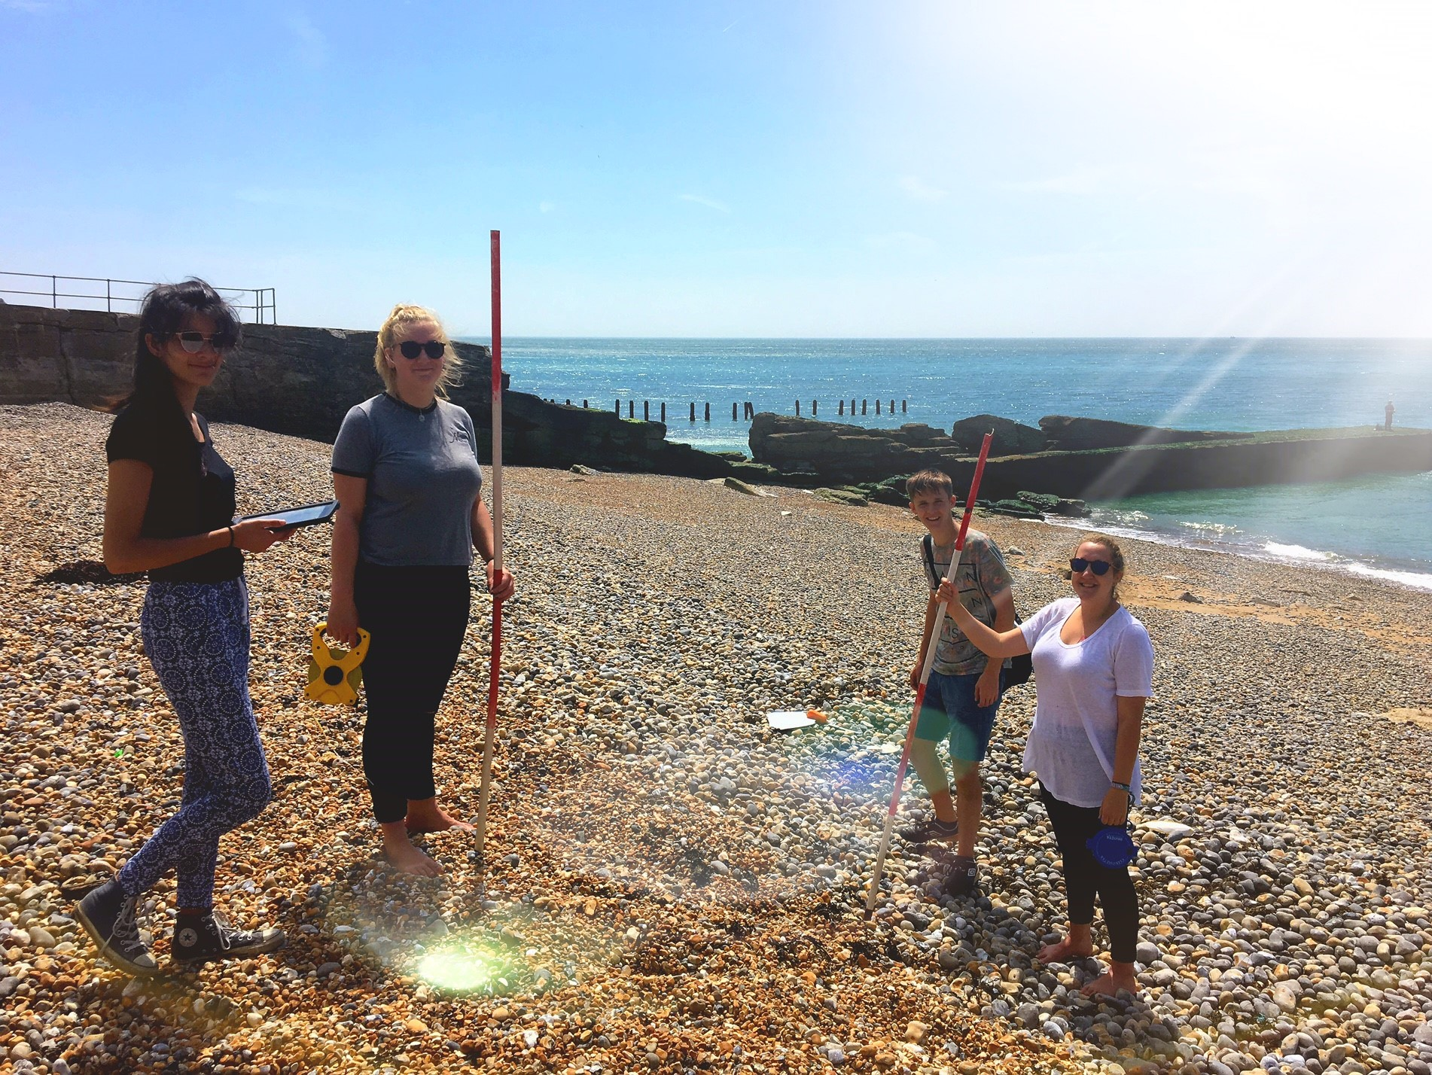
The role of ‘fieldwork’
FIELDWORK
‘Involves the collection of information from the world around us – with the aim of helping answer the questions we have about the landscape’

Slide 8
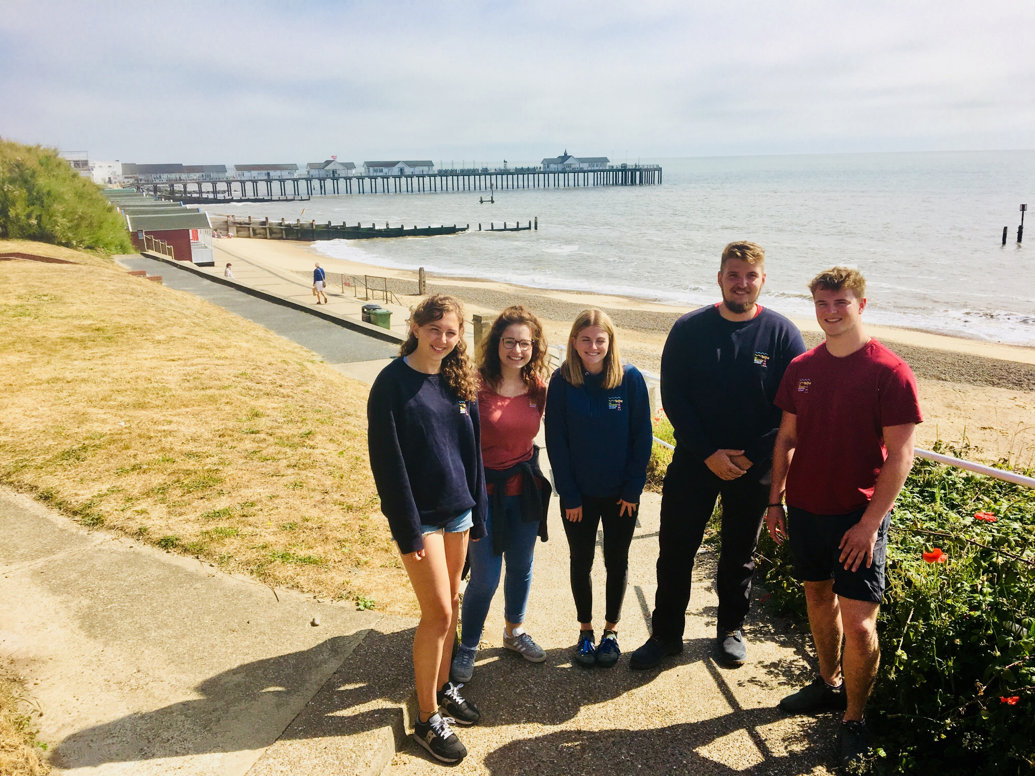
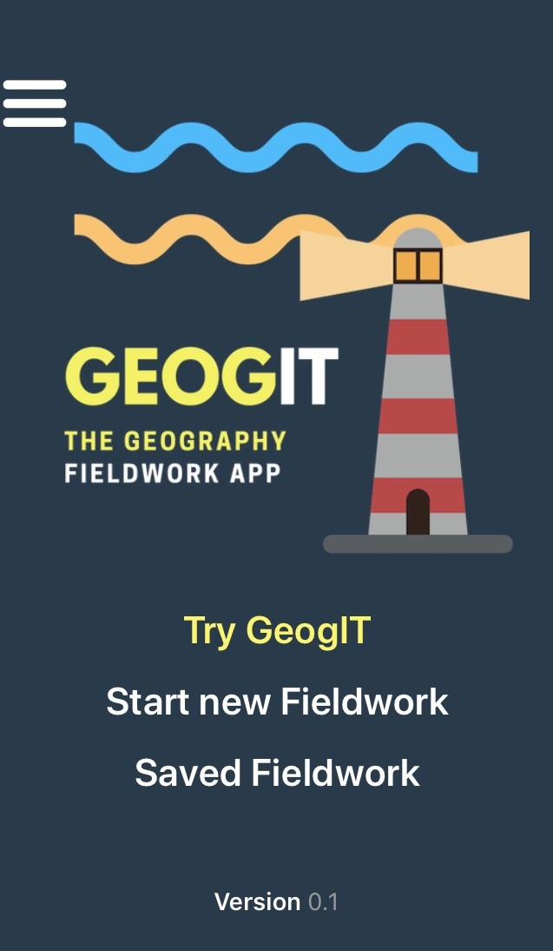
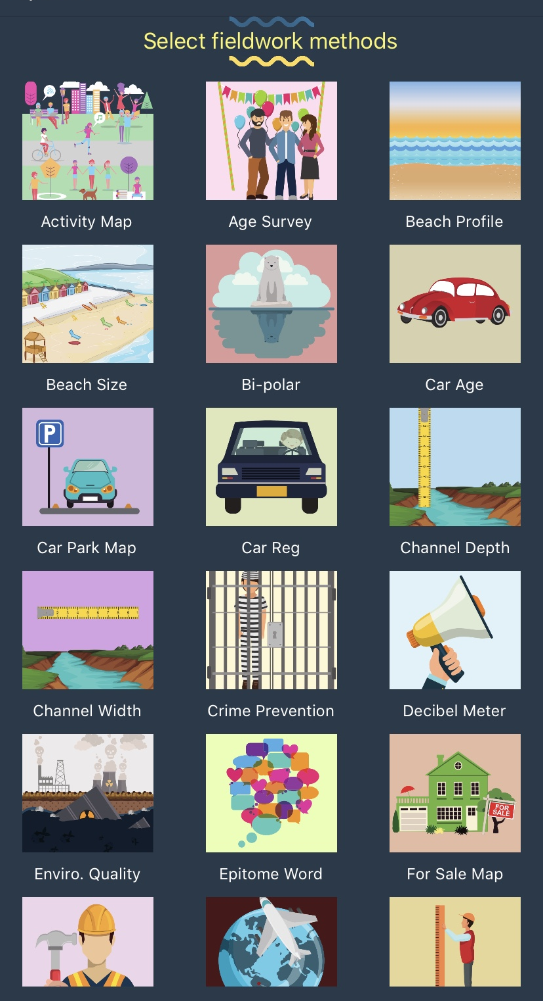
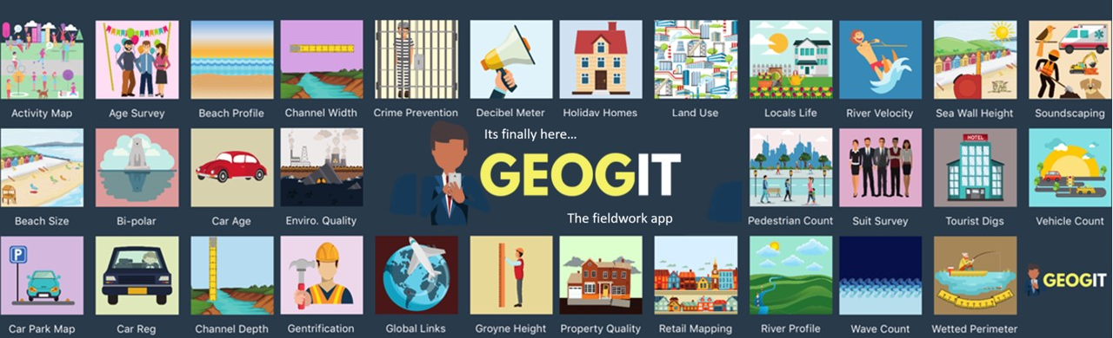
Interpret real fieldwork data collected from the Broads
During the summer of 2020, the tutor team from the Geography Fieldwork Academy collected data from the Broads National Park using GeogIT, the fieldwork app - it is now your job to interpret it.

Slide 9
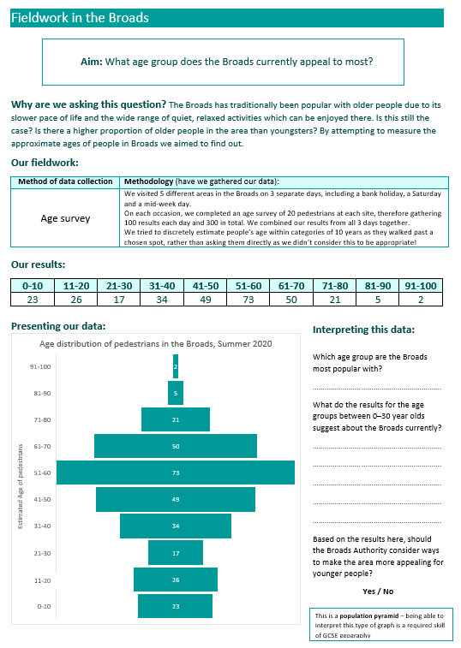
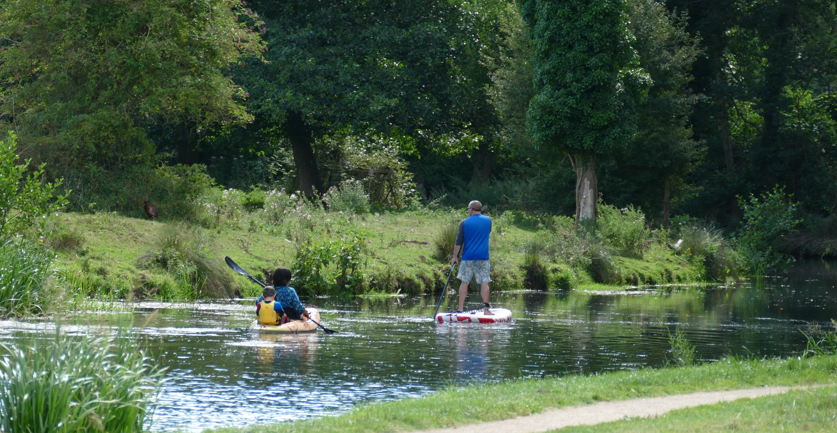
Interpret real fieldwork data collected from the Broads
Who uses the Broads?
What age group does it appeal to?
Finished? Consider the limitations:
Justify how reliable you think this method of data collection is?

Slide 10
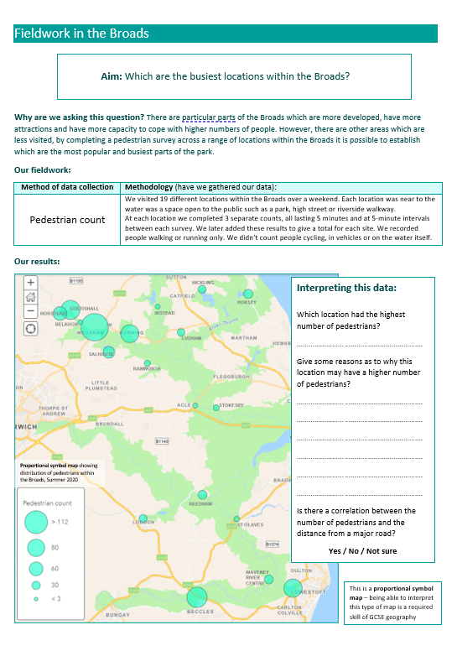
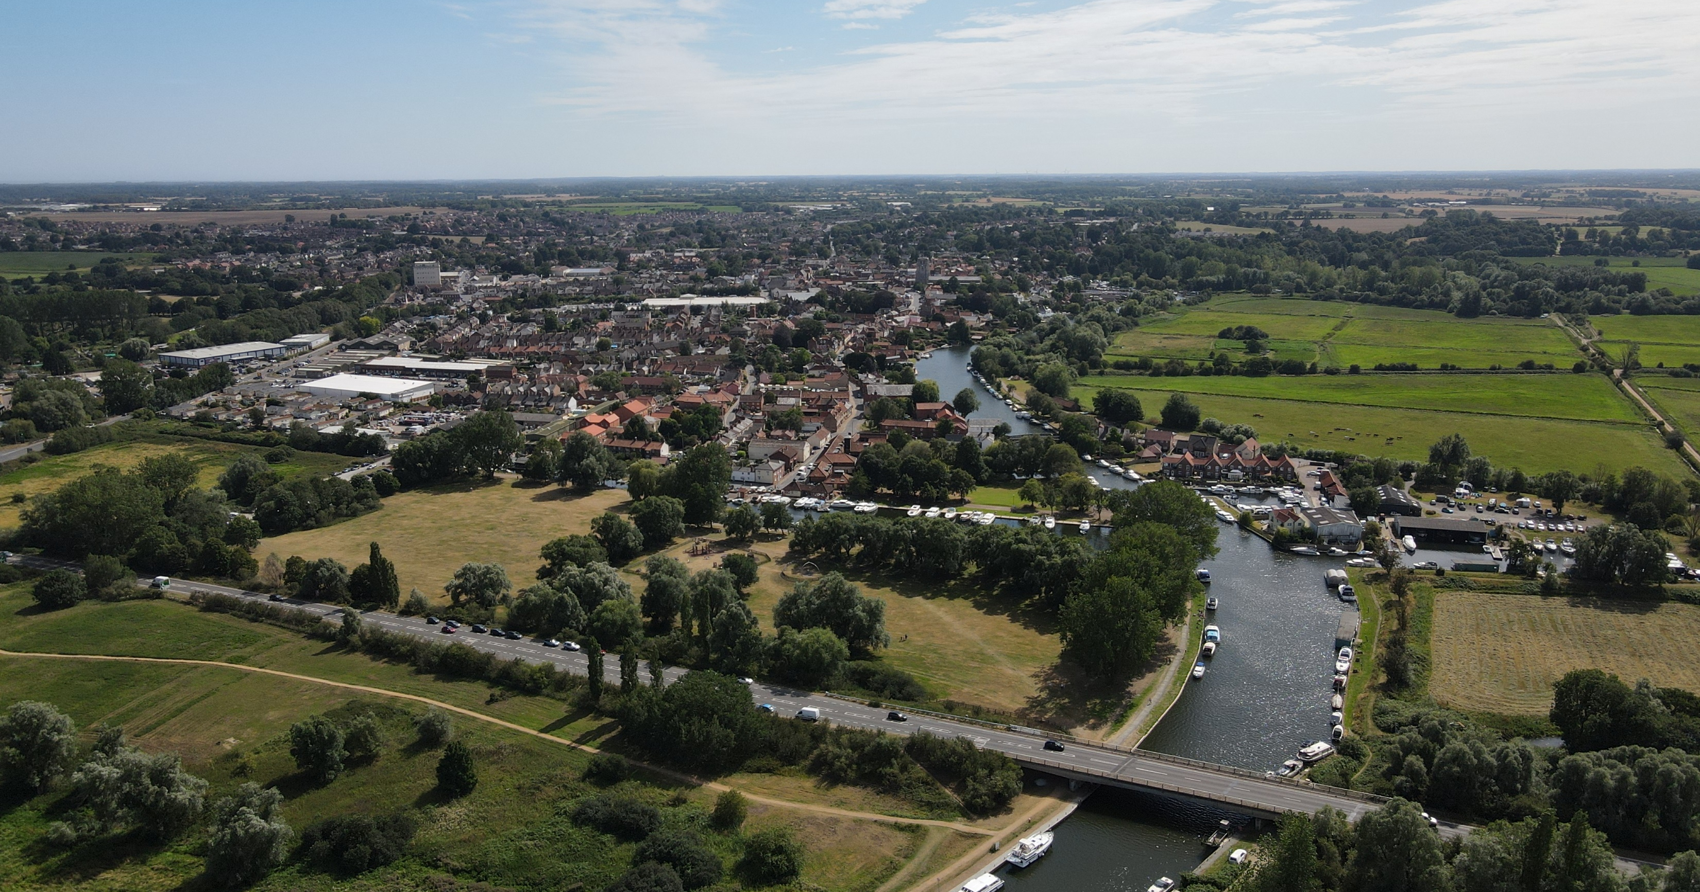
Interpret real fieldwork data collected from the Broads
Where are the busiest parts of the Broads?
Are there areas which are significantly quieter?
Finished?
Consider the limitations:
Why may it be difficult to accurately compare pedestrian numbers between places?

Slide 11
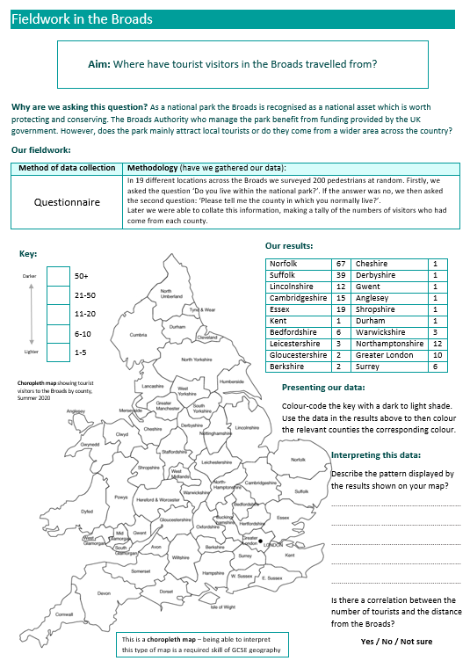
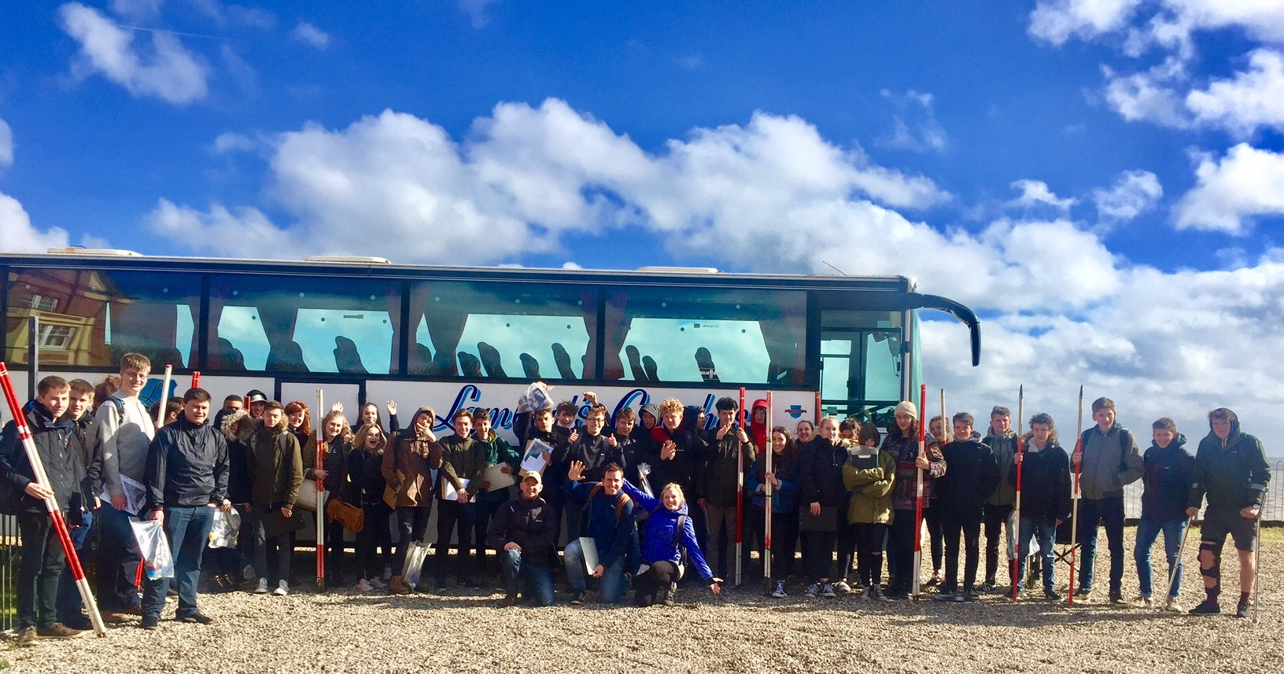
Interpret real fieldwork data collected from the Broads
Where have people come from to visit the Broads?
Is it mainly used by local people?
Finished?
Consider the limitations:
How may these results be different if the data was gathered in the winter?

Slide 12
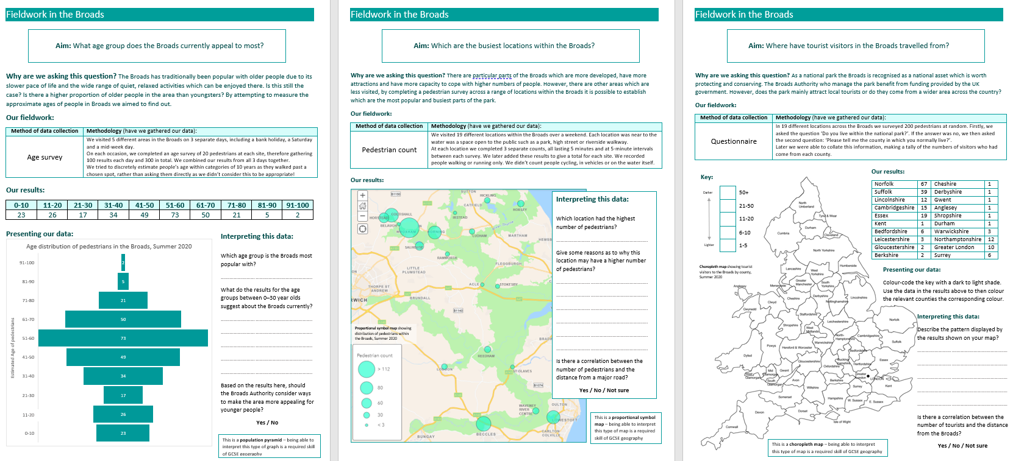
Interpret real fieldwork data collected from the Broads
Drawing conclusions from this fieldwork
Task:
Complete a ‘key detail’ summary of the findings of this fieldwork in no more than 100 words.
Tip: Refer back to the questions set by our ‘aims’

Slide 13
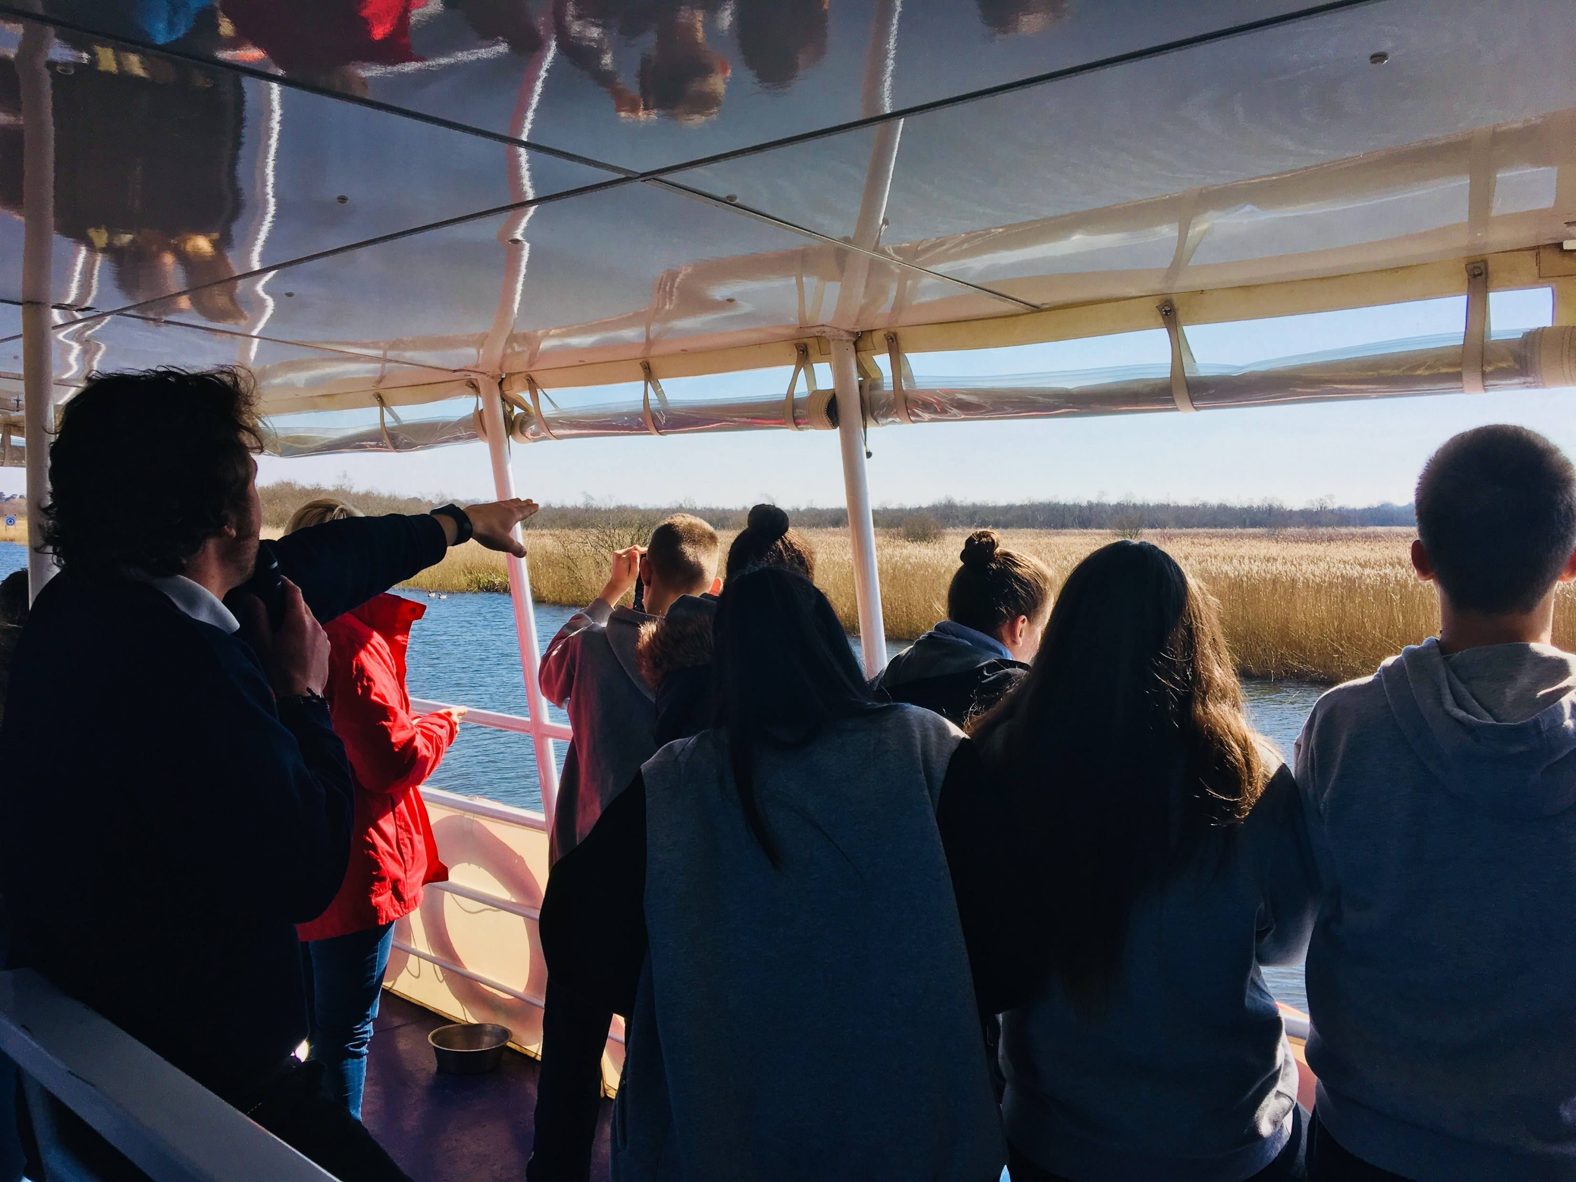
In this lesson, we have:
Considered the role of fieldwork to ask questions about the landscape
Interpreted and presented real fieldwork data collected from the Broads
Assessed the limitations of fieldwork methods
Challenge 1
Challenge 2
Challenge 3
Name 3 types of data collection methods
Name 2 types of map which can be used to present fieldwork data
Give 3 likely limitations of completing fieldwork in the summer?
Educational resource partner providers

